Slide 1
Veterans Treatment Courts
Battlemind to Home II Symposium
Judge Robert Russell
Notes:
1

Slide 2


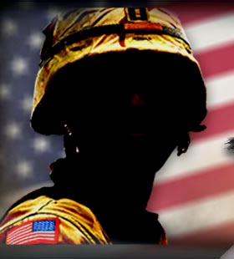
Post-9/11 Veterans:
Who are they?
Over 2 million deployed to the Global War on Terror (GWOT)
810,000 have deployed more than once to Operations Enduring and Iraqi Freedom (OEF/OIF)
Over 1 million currently separated from active duty AND eligible for VA services

Slide 3





Reserve and National Guard
254,000 Reservists and 332,000 National Guard members have deployed to OEF/OIF
Increased stress on families, employment, and housing
Notes:
More National Guard members have deployed to OIF/OEF than Drilling Reservist (332,000 Guardsmen compared to 254,000 Reservists)
National Guard OIF/OEF veterans tend to be older, with an average age of 37
30% of Reserve and National Guard members identify themselves as a member of a racial or ethnic minority
The National Guard is being transformed into an operational force to be frequently deployed; this represents a shift away from its traditional role as a force primarily designed for infrequent federal use against a large nation-state

Slide 4
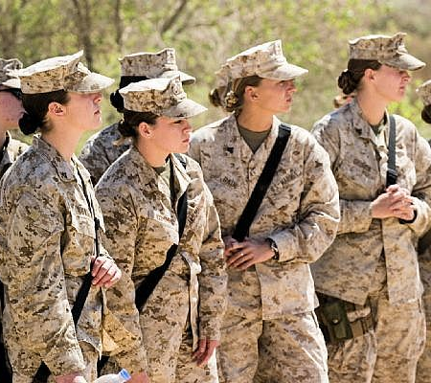
Women Veterans
15% of today’s military
Over 235,000 served in OEF/OIF
12%-16% are single parents
Approximately 10% of homeless Veterans < 45
2 times more likely to become homeless than non-Veteran women

Slide 5
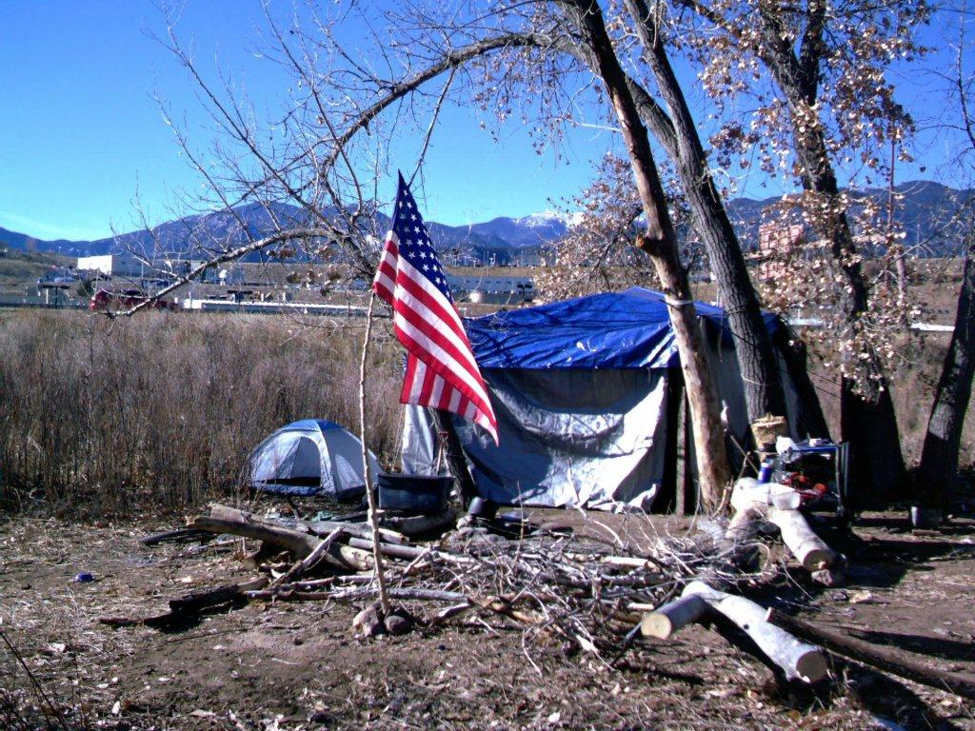
Homelessness
Veterans twice as likely to become homeless as non-Veterans
Criminal involvement is single best predicator of future homelessness
Notes:
In general the term “homeless” includes an individual who lacks a fixed, regular, and adequate nighttime residence and an individual whose primary nighttime residence is a shelter designed to provide temporaryliving accommodations.45
➢By 2009, 3,000 Iraq and Afghanistan veterans have sought assistance from VA homeless services. 1,200 of these veterans sought these services in 2008 alone.46
➢The VA estimates that on any given night in 2008 approximately 131,000 veterans were homeless.47
➢An estimated twice as many (262,000) experience homelessness at some point during the course of a year.
➢In 2008 the VA reported a 24% increase in the number of homeless veterans with families.48
➢Not all homeless veterans use VA services and thus the real number of homeless veterans may be significantly higher.

Slide 6
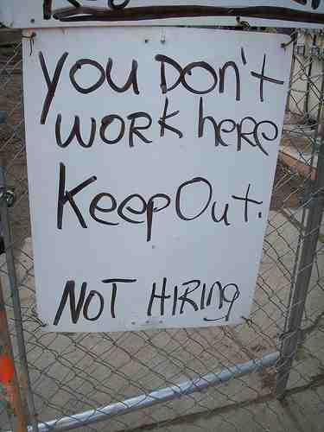
Unemployment
In 2008, 18% of recently separated Veterans were unemployed
In 2009, Male Veterans, aged 18-24, unemployment rate was 21.6%
Notes:
A 2008 study for the VA found that 18% of veterans recently separated from service are unemployed, and of those employed, 25% earn less than $21,840 a year.49
➢The Bureau of Labor Statistics reported that in 2009 young male veterans aged 18-24 had an unemployment rate of 21.6%.50
➢One in four military households have sought loans from predatory lenders that can carry interest rates of 400% or higher.51Fortunately, recent legislation has capped new loan interest rates to service members at 36%.52
Veterans regularly express difficulty transferring their military skills to the civilian workforce.
➢Guard and Reserve troops often find their jobs no longer exist, or their employers have folded, down-sized, merged or relocated.

Slide 7
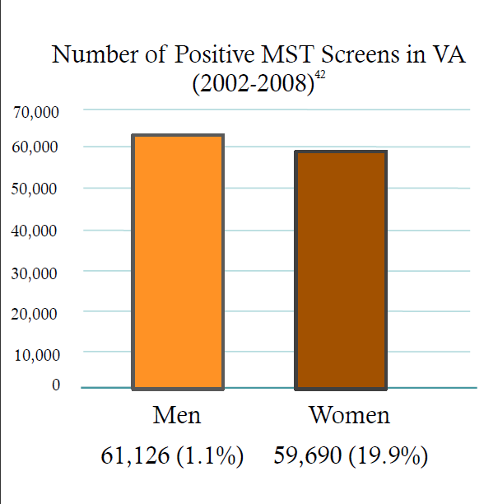
Military Sexual Trauma (MST)
Both sexual harassment and sexual assault that occurs in military settings.
60% of women with Military Sexual Trauma also suffered from PTSD.
Notes:
Military Sexual Trauma (MST) refers to both sexual harassment and sexual assault that occurs in military settings.
➢Service members often wait until they are out of the service to seek treatment for MST.
➢Since 2002 VA has been screening all veterans for Military Sexual Trauma.
➢Of the 5,777,169 veterans screened for MST between 2002 and 2008, 61,126 (1.1%) male veterans screened positive for MST and 59,690 (19.9%) female veterans screened positive for MST.43
➢60% of women with Military Sexual Trauma also suffered from Post Traumatic Stress Disorder.44

Slide 8
Buffalo’s Experience :Veterans Tx Court
Treatment Court Background-Drug & Mental Health Courts
Veterans seen in Treatment Courts
Facilitation by fellow Veterans
Visit to Buffalo Veterans Hospital Advisory Board, (WNY) V.A. Director Michael Finnegan
Community forums with Veterans Health Care, the Court and Community Behavioral Health Care Providers-Keynote Speaker Deputy Under Secretary William Feeley
Notes:
Veterans Being Compensated for PTSD
More than 200,000 veterans were listed by the VA in 2005 as having PTSD as a service-connected disability.
PeriodSept. 05Pre-WWII-WWII25,278Korea10,944Vietnam179,713Gulf War19,356Peacetime9,087Total 244,846

Slide 9
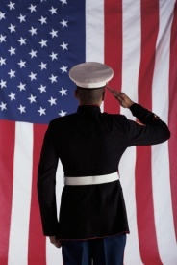


Veterans Court
A specialized criminal court docket
Established to address the needs of veteran-defendants with substance dependency and/or mental illness issues
Primarily non-violent felony or misdemeanor offenses (violent offenses: case by case)
Substitution of treatment problem solving model for traditional court processing
Notes:
9

Slide 10
Target Population/Eligibility
Combat vs. Non-combat
Violent Offenders
Active Duty, Reservists, National Guard
High Risk, High Need
Military Discharge Status
VA Eligibility

Slide 11

Our Mission
To successfully habilitate veterans by diverting them from the traditional criminal justice system and providing them with the tools they need in order to lead a productive and law-abiding lifestyle.
Our Goal
Our program’s goal is to reduce the veterans’ inappropriate behavior while helping them turn their lives around. We will find them, offer them assistance, assess their needs, manage their care and help them solve their problems.

Slide 12
Our Objective
To provide Veterans with substance abuse, alcoholism and mental health treatment coupled with academic/vocational skills improvement, while actively assisting with residential, outpatient and/or transitional services leading to job placement and job retention.

Slide 13
EARLY IDENTIFICATION
Veterans are identified through evidence based screening and assessments. They voluntarily participate in a judicially supervised treatment plan that a team of court staff, veteran health care professionals, veteran peer mentors, AOD health care professionals and mental health professionals develop with the veteran.

Slide 14
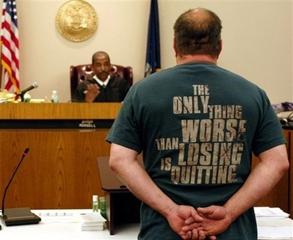
Notes:
Wounds of War
Some wounds of war
Are never seen
They're buried deep within
No open wound
No Purple Heart
No blemish on the skin
But these are wounds
That leave a scar
Upon our very soul
They tear our hearts
Cause misery
And take a heavy toll
Our bloodless wounds
Cause us to ask
Oh GOD,what was it for
We go through life
Not knowing why
We have these Wounds of War

Slide 21
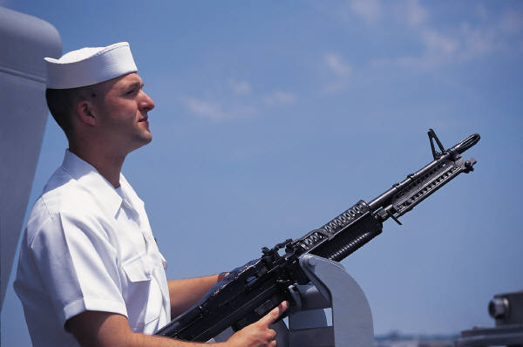
Participants
Veterans (family members?)
Legal defense team & Prosecutor
Court staff
Veteran health care professionals
Veteran peer mentors
AOD health care professionals
Mental health professional
VA benefit coordinators
Notes:
21

Slide 22
Unique Components
Court entirely of Veterans
In Court: Veterans Health Care Worker(s)
Veteran Mentors
Therapeutic Environment
Hybrid Drug & Mental Health Court

Slide 23
V.A. Health Care Worker
Tamekia Slaughter, (SATS) Veterans Justice Outreach, Tel # 716-862-3100
Liaison
Obtaining VA Releases of Information
Facilitating VA linkages for services
Coordinating and providing VA status report regarding Tx, toxs, appointments, etc.
Case management & crisis management

Slide 24
FEDERAL OFFICE OF VETERANS BENEFIT AFFAIRS
Carly Klein and Timothy Philo, Veteran Service Representatives-716-857-3188 & 716-857-3315
Liaison
Obtaining VA Releases of Information
Facilitate processing or review of Pension Disability Benefits
Process review of potential errors or corrections on veterans DD214

Slide 25

Challenge
Overcoming “Warrior mentality”
Notes:
25

Slide 26
Veteran Mentors
“Leave no one behind”
Notes:
Combat
Roaring noises
Screaming voices
Metal flying
There and here
Eyes are burning
Guts are churning
Men are fighting
Full of fear
Guns are smoking
Lungs are choking
Thru it all
Godawful smell
I hear crying
Men are dying
I'm alive
But I'm in hell

Slide 27
Veteran Mentors Role
Coach
Facilitator
Advisor
Sponsor
Support
Notes:
Combat
Roaring noises
Screaming voices
Metal flying
There and here
Eyes are burning
Guts are churning
Men are fighting
Full of fear
Guns are smoking
Lungs are choking
Thru it all
Godawful smell
I hear crying
Men are dying
I'm alive
But I'm in hell

Slide 28
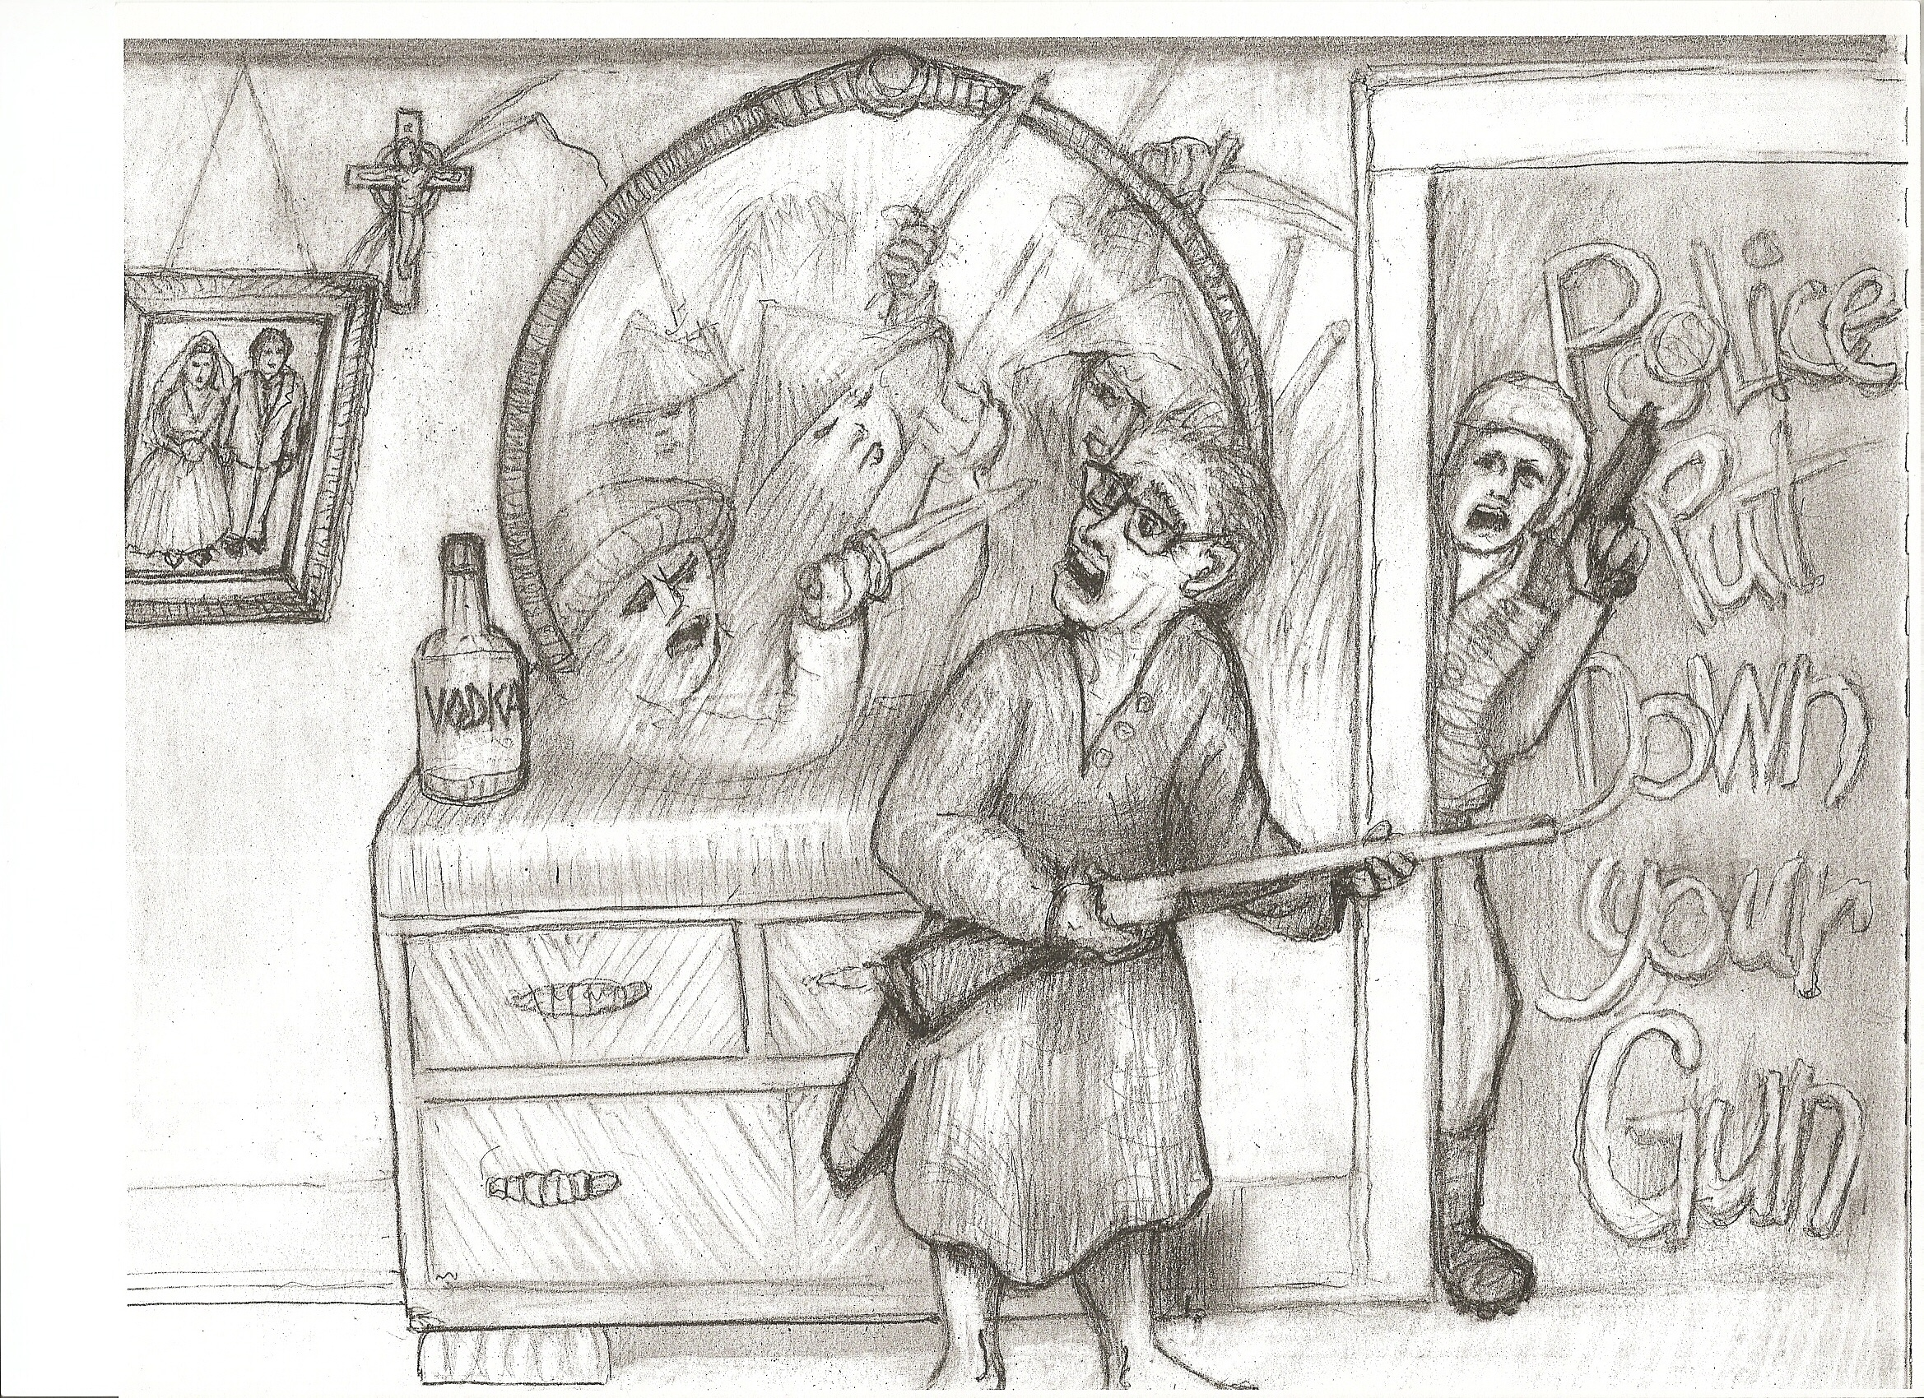
Notes:
Weapons
There are many types of weapons
But the ones that hurt the most
Are the weapons made of memories
And the deadly midnight ghost
Not all wounds are red and bloody
There are wounds that touch the mind
These are wounds that always fester
They're the never healing kind
Why are we who've done our duty
Plagued by wounds that never heal
Made by weapons of our memories
Which are worse than lead and steel

Slide 29

KEY COMPONENTS
Key Components adapted from Drug Treatment and Mental Health Treatment Courts
Resources: WWW.NADCP.ORG
Veterans Treatment Court Clearinghouse
WWW.BUFFALOVETERANSCOURT.ORG

Slide 30
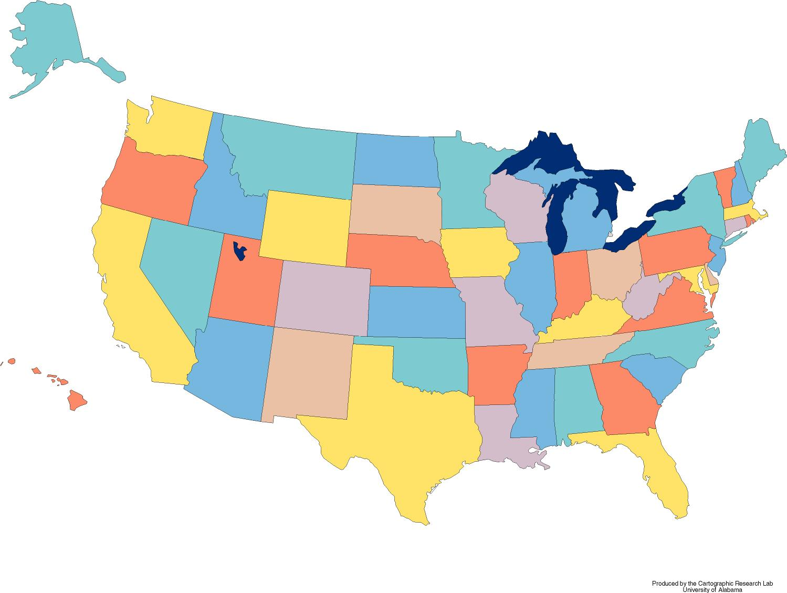
Veterans Treatment Courts
1
4
1
1
1
3
7
4
6
1
4
2
7
1
1
8
1
1
2
2
2
2
1
3
8
1
Mentor Courts
Buffalo, NY
Tulsa, OK
Orange Co., CA
Santa Clara Co., CA
3

Slide 31
CONTACT INFORMATION
JUDGE ROBERT RUSSELL
716-845-2623
JACK O’CONNOR, Mentor Coor.
716-858-7345
HANK PIROWSKI, Project Director
716-845-2695
Tamekia Slaughter, VJO
716-862-3100
Carly Klien, & Timothy Philo, VSR,
716-857-3188 & 716-857-3315
Resource: WWW.NADCP.ORG & WWW.BUFFALOVETERANSCOURT.ORG

Slide 32
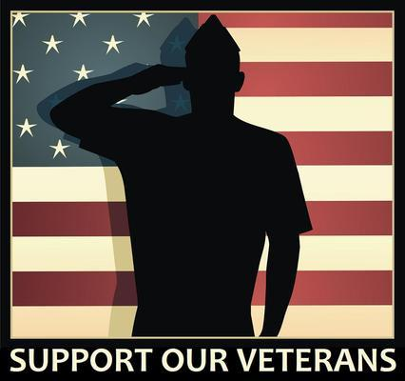
Thank you for your support
Notes:
32

