Slide 1

“Engaging Spiritual Resources for our Returning Warriors/ Combat Veterans and their Families to Help them Heal”
“Engaging Spiritual Resources for our Returning Warriors/ Combat Veterans and their Families to Help them Heal”
Chaplain Michael L. McCoy, M. Div, CCC, LVA,CMT
Associate Director
National Chaplain Center
Department of Veterans Affairs

Slide 2
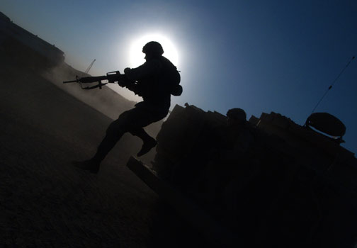
A Prayer for Veterans & Families

Slide 3
OBJECTIVES
To consider how spiritual care and meaning-making is central to the care of Veterans/combat warriors.
Examine the spiritual reactions to trauma, and pastoral care approaches.
Gain an understanding of the returning
warrior/Veteran use of chaplains and community clergy. Understand the important role of the clergy and the faith community.
Provide education and resource literature for community clergy regarding the physical, psycho/social, and spiritual issues experienced by returning warriors.

Slide 4
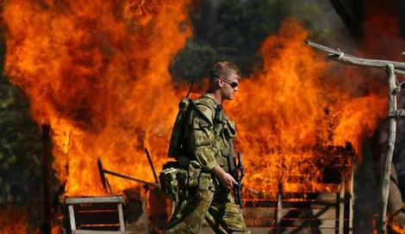

Slide 5
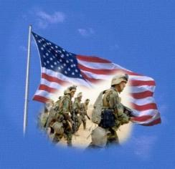
OEF/OIF Veterans
Approximately 800,000 Service members have left the active duty service since 9/11
Where are these veterans today?
Back home in our local communities...
How many of you personally know an Afghanistan or Iraqi veteran who is off active duty and is now back home?
Who do these veterans and their families turn to first for help?
Local Community Resources!
Religious Community
Community Organizations

Slide 6

OEF/OIF Veterans
Over half of the service members deployed in Iraq and Afghanistan are Reserve or National Guard.
When they return home from deployment they often live long distances from their Reserve and National Guard Training Centers.
When these Reservist and National Guard members struggle to cope with the scars of battle, who do they turn to first? Who will be there for them when they experience the NORMAL reactions to very traumatic events?
.

Slide 7
Returning Home after Trauma
A returning warrior is not the person he or she was before leaving home for war.
The return home is disorienting and can represent an absence of social community.
This feeling is upsetting for friends and family who awaited the warrior’s return.
The enormity of the experience shatters the individual’s basic sense of safety.
Even the most well-adjusted will re-experience a total lack of safety when triggered.

Slide 8
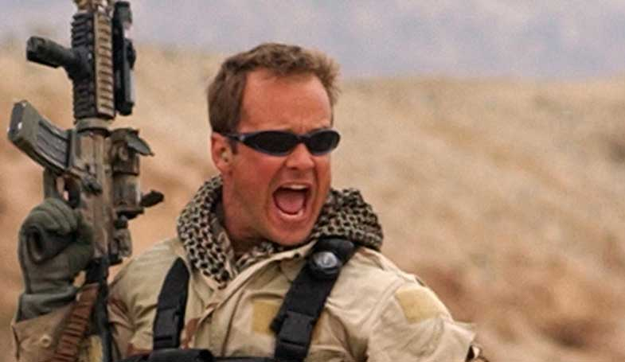

Slide 9
Training Addresses Normal Reactions to Traumatic Events
Psychological
Emotional
Cognitive
Physical
Behavioral
Spiritual

Slide 10
Psychological Reactions to Trauma
Traumatic events are often re-experienced in the following ways:
Recurrent and intrusive distressing recollections of the event, including images, thoughts, or perceptions.
Recurrent distressing dreams of the event.
Acting or feeling as if the traumatic event were recurring.
Intense psychological distress at exposure to internal or external cues that symbolize or resemble an aspect of the traumatic event.

Slide 11
Psychological Reactions (cont.)
Physiological reactivity on exposure to internal or external cues that symbolize or resemble an aspect of the traumatic event
Hyper-vigilance, jumpiness, an extreme sense of being "on guard“ overreactions, including sudden unprovoked anger
General anxiety
Insomnia
Obsessions with death

Slide 12
Physical Reactions to Trauma
Eating disturbances (more or less than usual)
Sleep disturbances (more or less than usual)
Sexual dysfunction
Low energy
Chronic, unexplained pain
Traumatic Brain Injury

Slide 13
Emotional Reactions to Trauma
Depression, spontaneous crying, despair and hopelessness
Anxiety
Panic attacks
Fearfulness
Compulsive and obsessive behaviors
Feeling out of control
Irritability, angry and resentment
Emotional numbness
Withdrawal from normal routine and relationships

Slide 14
Emotional Reactions (cont.)
Emotional numbing and avoidance
Amnesia
Avoidance of situations that resemble the initial event
Detachment
Depression
Guilt feelings
Grief reactions
Altered sense of time

Slide 15
Behavioral Reactions to Trauma
Common personal and behavioral effects of emotional trauma:
Substance abuse
Compulsive behavior patterns
Self-destructive and impulsive behavior
Uncontrollable reactive thoughts
Inability to make healthy professional or lifestyle choices
Dissociative symptoms ("splitting off" parts of the self)
Feelings of ineffectiveness, shame, despair, hopelessness
Feeling permanently damaged
Loss of previously sustained beliefs

Slide 16
Trauma’s Effect on Interpersonal Life
Common effects on interpersonal relationships:
Inability to maintain close relationships or choose appropriate friends and mates
Sexual problems
Hostility
Arguments with family members, employers or co-workers
Social withdrawal
Feeling constantly threatened

Slide 17
Cognitive Reactions to Trauma
Memory lapses, especially about the trauma
Difficulty making decisions
Decreased ability to concentrate
Feeling distracted

Slide 18
Spiritual Reactions to Trauma
Confusion about God
Altered sense of meaning in/of life
Grief and loss issues
Questions of Theodicy
Feelings of ineffectiveness, shame, despair, hopelessness
Feeling permanently damaged
Loss of previously sustained beliefs
Feelings of guilt
Confusion about core ethical beliefs.

Slide 19

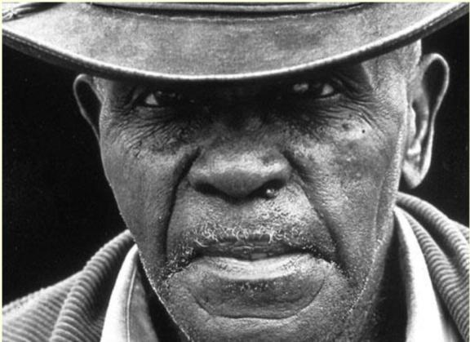
What is Spirituality?
Spirituality can be defined as the essence of our humanity.
Frankl

Slide 20
Spirituality
Spirituality is a capacity and tendency that is innate and unique to all persons.
Spiritual tends to move individuals toward knowledge, love, meaning, peace, hope, transcendence, connectedness, compassion, wellness,and wholeness.
Spirituality includes one ’ s capacity for creativity, growth, and the development of a value system.
Spirituality encompasses a variety of phenomena including experiences, beliefs, and practices. While spirituality is usually expressed through culture, it bothprecedes and transcends culture.
Association for Spiritual, Ethical, and Religious Values in Counseling

Slide 21

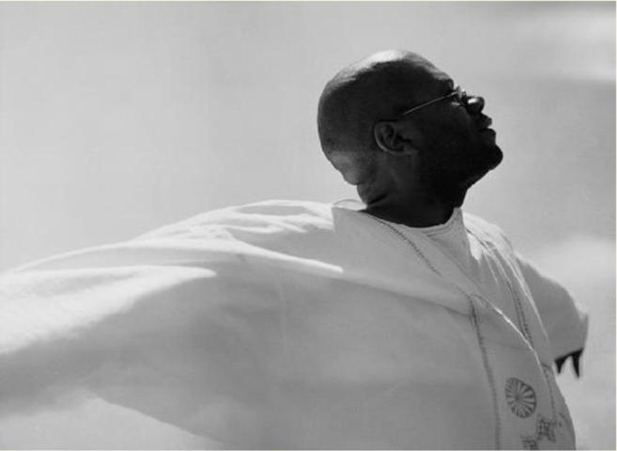
Spirit
is the animating life force. Spirituality is the drawing out and infusion of that spirit in one ’ s life.

Slide 22

Spirituality and Meaning
Spirituality leads one to search for and discover meaning in life, a meaning that goes beyond a merely material experience.
May

Slide 23
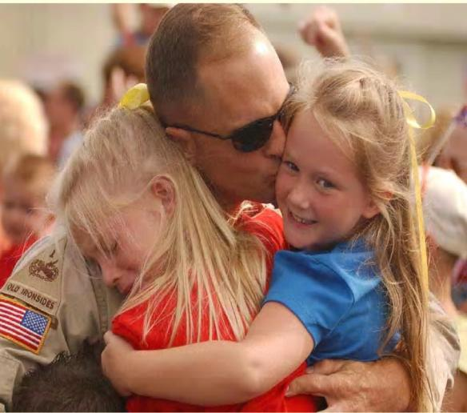
Spirituality and Meaning
He who has a why to live for can bear almost any how.
Nietzsche

Slide 24
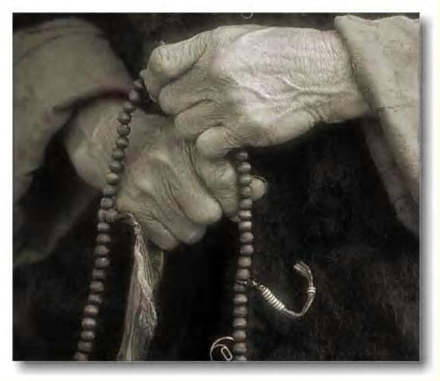
Spirituality and Meaning
The deeply personal search for meaning can bring a person to inner peace even in the presence of adverse circumstances.

Slide 25
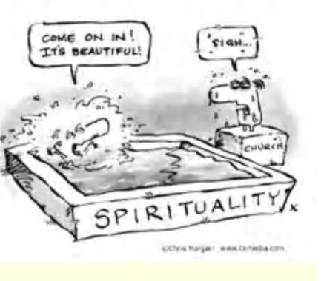
Spirituality and Religion
Spirituality is not the same thing as religion. While religion may be one way in which persons express or experience their spirituality, it is not the same as spirituality itself.
Religion can be thought of as the organization of belief which is common to a culture or subculture, “ the codified, institutionalized, and ritualized expressions of peoples ’ communal connections to the Ultimate
Kelly

Slide 26

Spirituality and Religion
Spirituality lights
the way
Religion interprets
the steps

Slide 27

Spirituality and Religion
Religion illumines
Spirituality warms

Slide 28

Spirituality and Religion
Spirituality is the dance
Religion is the steps

Slide 29
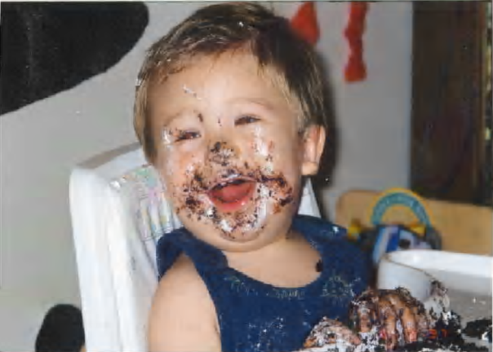
Spirituality and Religion
Religion sets the table
Spirituality enjoys the feast

Slide 30
Spirituality and Suffering
It is our responsibility to listen to people as they struggle with their life experiences.
We need to be willing to listen to their anxieties, their fears,their unresolved conflicts, their hopes and their despair.
If people are stuck in despair, they will suffer deeply.
It is through spirituality that people become unstuck from despair.
Viktor Frankl wrote that man is not destroyed by suffering; he is destroyed by suffering without meaning.
Spirituality helps give meaning to people ’ s suffering. It helps people find hope in the midst of despair.
We as caregivers need to engage with our patients on the spiritual level.
Christina M. Puchalski

Slide 31
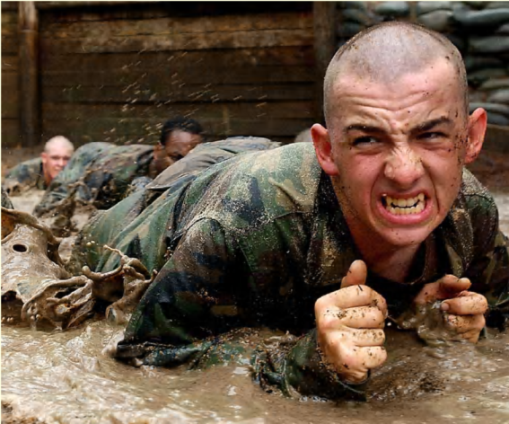
Spirituality and Suffering
Suffering and trouble belong to life as much as fate and death.
None of these can be subtracted from life without destroying its meaning. . . . .

Slide 32
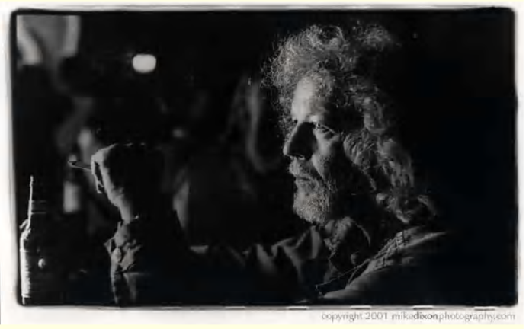
Spirituality and Suffering
To subtract trouble, death, fate, and suffering from life would mean stripping life of its form and shape. . . .

Slide 33
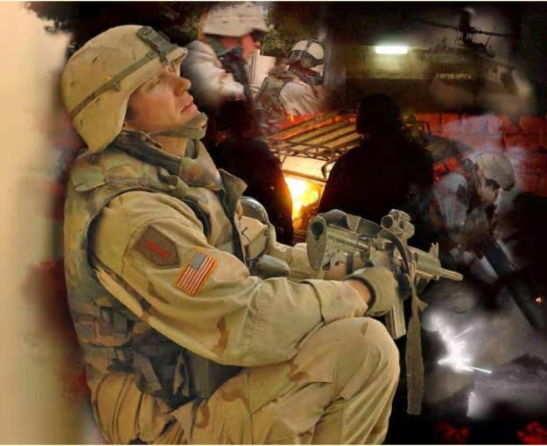
Spirituality and Suffering
Only under the hammer blows of fate, in the white heat of suffering, does life gain shape and form.
Frankl

Slide 34
Spiritual Resources
Types of Spiritual Resources
Religious Spiritual Resources
Non-Religious Spiritual Resources
Ways Spiritual Resources are lived out.

Slide 35
Religious Spiritual Resources
Sacraments (Rites that mediate divine grace—a holy mystery.) Rituals (Actions performed mainly for their symbolic value, the value is prescribed by a religion or by the traditions of a community.) Prayer / Meditation
Sacred Texts / Hymns of Faith / Sacred objects
Aesthetics: Music / Art / Architecture / Literature / Icons / Scents
Established Core Community
Vocation / Outreach to community

Slide 36
Non-Religious Spiritual Resources
Aesthetic Resources
Music
Art
Nature
Physical Resources
Human touch
Exercise
Food
Pets
Support Communities
Vocational Involvement
Environment
Nature / Gardening
Quiet
Altruism Community Responsibility and Action
Family / Intimacy
Education / Learning

Slide 37
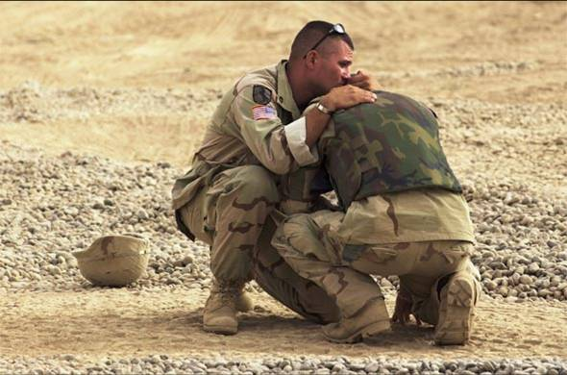
We All Need Help Sometime in Life!

Slide 38
Veteran’s Use of Clergy
Veterans feel more comfortable approaching their pastor than they do a mental health professional.
Research shows that 4 of 10 individuals with mental health challenges seek counseling from clergy.
Individuals seek council from ministers more than all other mental health providers combined.
Often seeing a member of the clergy is less threatening and has less stigma attached. Is viewed as engaging a known community resource.
Negative reasons. . . Magical thinking, avoiding truth of diagnosis, etc.

Slide 39
Pastoral Care Approaches
Safe Haven
Listening
Grounding
Accepting

Slide 40
Pastoral Care Approaches
Safe Haven
Listening
Grounding
Accepting

Slide 41
Pastor as a Safe Haven
Pastor as a Safe Haven
Offer a calm, safe, and non-judgmental, non-anxious presence.
Provide clear, reliable boundaries of communion and respect.
Be present with veterans and families during the storms of reintegration.
Provide a compassionate space wide enough to encompass the awfulness of war trauma.

Slide 42
Pastor as Listener
Pastoral Care Approach:
Avoid advising or offering platitudes
Listen without interruption or comment
Hearing content and emotion with respect
Convey warmth and acceptance of the person, their journey and their struggles
Avoid asking questions
Notice what is in a caring and genuine way.

Slide 43
Pastor’s Role in Grounding
Pastoral Care Approach:
Provide roadmap for reintegration into church community and community at large.
Provide roadmap of opportunities for appropriate outlets regarding frustration, pain, fear, guilt and trauma.
Provide avenues of dialogue for spiritual and religious growth and engagement.
Provide honest and realistic reflection of recovery process.
Provide spiritual, religious and community resources for veterans and their families.

Slide 44
Pastor’s Role in Accepting
Pastoral Care approach:
Understand the “both/and” nature of good and evil. Then and now.
Not trying to fix the unfixable.
To offer deep reflection on “what is goodness” and how to help other find “goodness” within themselves.
Understanding and accepting the dark side of human nature.

Slide 45
Coordination and Collaboration with Community Clergy
Chaplain Service Veteran’s Community Outreach Initiative (VCOI)
More than 800,000 veterans have left military since these current wars began and are now readjusting to civilian life.
Community Clergy will be the first contact for many veterans and their spouses or family members when the veteran experiences distress related to combat experiences.
Local Chaplain Services sponsor clergy educational day events all around the country to help clergy to understand the needs of returning warriors and how to make referral to the VA when needed.

Slide 46
Training Includes Sessions on Suicide Prevention
Risk of Suicide among male veterans is double that of the general population
Guard and Reserve account for 53% of suicides from 2001-2005.
Over half were between 20 & 29 years old.
82% were white
Rolling up data from each state, a CBS investigation found in 2005, 120 veterans or active military killed themselves every week totally 6,256 of those serving in the armed forces.
VA and DOD argue that only there were 283 suicides in the same time period.
National Suicide Hotline 1-800-TALK (8255)

Slide 47
VA Chaplains/Military Chaplains A Valuable Resource
Meet …
Invite …
Partner …
Together we can provide hope to Veterans/Returning warriors and their families in the healing process.

Slide 48
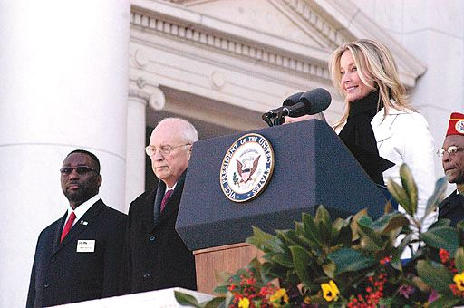
Veterans Day 2008 Arlington National Cemetery

Slide 49
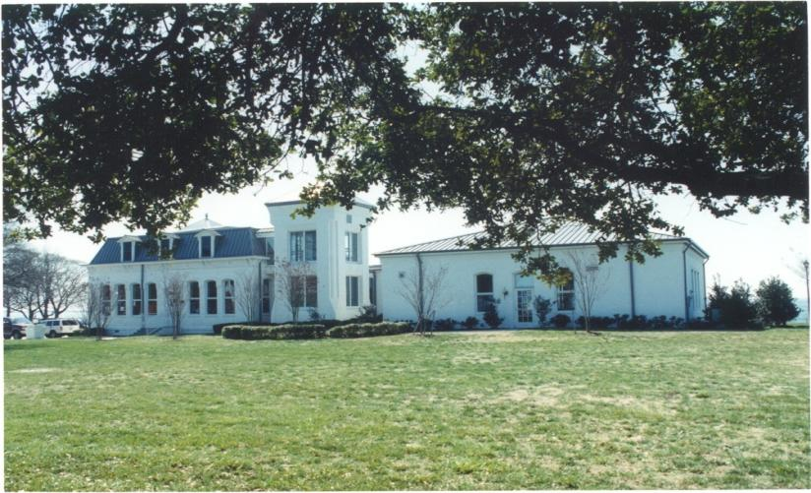
NATIONAL CHAPLAIN CENTER HAMPTON, VIRGINIA

Slide 50
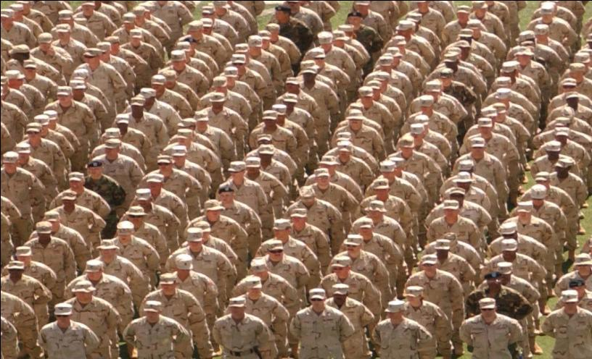
Operation Family Support: You and I Can Help!

Slide 51


Slide 52
Resources
http://www.helpguide.org/mental/emotional_psychological_trauma.htm
http://www.hooah4health.com/mind/combatstress/default.htm
www.ncptsd.va.gov
www.welcomethemhomebook.com
Acknowledgement and thanks are extended to
John P. Oliver, D. Min.
Chief, Chaplain Service
Durham, North Carolina VA Medical Center for his assistance in providing some of the slides in this presentation

