Slide 1
Dr. Grant Evans, CEO Lt. Col. Brian Gale, (Ret.), CFO, COO Director of Families of Fallen Hero’s
Austin, Texas

Slide 2
Contents
The Leadership Team
Operation R and R Fact Paper
Operation R and R presentation
Aug 11- Jan 13 Strategic Plan

Slide 3
Leadership Team

Slide 4
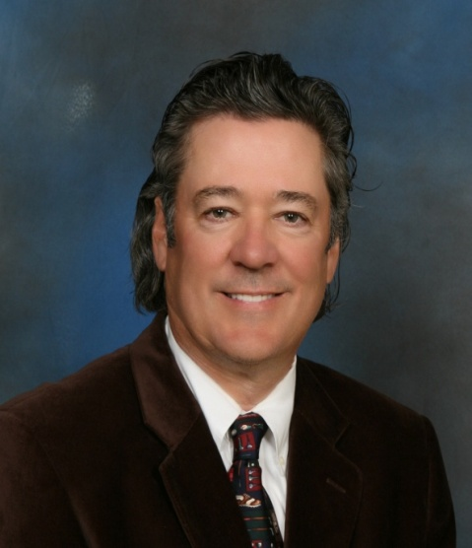
Leadership Team
Dr. Grant Evans, the CEO and Founder, started Operation R&R with his wife Mia, in early 2008. Living on Hilton Head Island, near the Ft. Stewart and Hunter Army Bases in Savannah, and seeing the strain on the faces of these military family members who have been apart for so long, Grant and his wife felt that something needed to be done!
Prior to being recently involved on a full time basis with Operation R&R, Grant owned and operated a large and successful Chiropractic practice in Columbus, Ohio for the past 30 years. He graduated from the Univ. of Pittsburgh and then attended Chiropractic School for 5 years in Chicago, Ill.
The last 3 years, Grant has started and successfully built the Operation R&R organization into one of the largest and most successful non-profits on Hilton Head Island. Due to the success and the tremendous need nationally for “military family support”, the decision was obvious in moving forward in establishing other “Affiliate Chapters” of R&R across the country.
Grant and his wife Mia of 32 years still split time between South Carolina and Ohio. They both have and continue to do volunteer work for Kairos International which is a men and women’s Christian Prison Ministry. Grant is an avid golfer and also enjoys bike riding and long walks on the beach with his wife and 3 Shit-sues

Slide 5
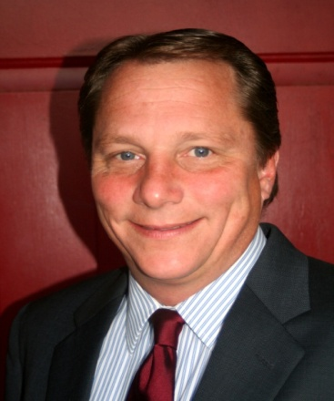
Leadership Team
Brian Gale is the Chief of Strategic Planning, Military Partnerships, and Strategic Communications. Additionally, he is the program manager for the Families of Fallen Hero’s Program. He is currently the acting CFO for Operation R and R, USA. He is a 21 year veteran of the United States Army retiring in 2009 as a Lieutenant Colonel.
Prior to joining the Operation R and R, USA team Brian held leadership and command staff positions at every level in the United States Army. He has commanded and lead Soldiers from a section of 5 to a Rear Detachment Brigade of over 4800 Soldiers and a staff of 100. His staff positions in the Army were varied and included time as an ROTC instructor at The Citadel, the Military College of South Carolina, and culminated with a position as the 3rd Infantry Division Chief of Strategic Plans and Communications.
Brian helped found Operation R and R Hilton Head with CEO Dr. Grant Evans, providing military partnerships, advice, and council to the organization, and remains active on the Board of Directors. A veteran of 2 deployments to Iraq and 4 years unaccompanied in Korea, Brian fully understands the challenges faced by returning service members from extended deployments, and the emotional, physical, and financial hardships and challenges of losing a service member in service to our country.
Brian graduated from The Citadel, the Military College of South Carolina in 1989, is Lean Six Sigma certified, and was selected as one of the top 41 leaders in Savannah, Georgia for 2010. He is very active in the community serving on the Board of Directors of 2 other local non-profit organizations supporting military families in coastal Georgia. He coaches high school and youth hockey teams, and assists with the local middle school golf team. He is married to his loving wife June and they have 5 active children. He currently resides in Richmond Hill, Georgia.

Slide 6
Program Overview
Background: Operation R&R originated in Hilton Head Island, SC in 2008 as a “designated fund” under the Community Foundation of the Lowcountry. It is a non-profit organization designed to provide service men and women an opportunity to reconnect with their spouses and children upon their return from extended deployments. Property owners donate their homes and villas to give military families a chance to spend some time away from their everyday lives to strengthen relationships strained due to long separations and extreme circumstances. In addition, businesses offer discounts, most are 50% or more and include restaurants, service-related businesses and grocery stores. To qualify for Operation R&R, service members must have served a world wide deployment in the past 18 months, be married, still enlisted and stationed at Fort Stewart in Hinesville (Ga.), Hunter Army Airfield in Savannah or the Marine Corps Air Station in Beaufort.
The program’s success has been documented by both local and national media, including a segment on Fox News. As a result, the decision was made to expand the program to other areas across the country with a goal of matching every military installation with a regional Operation R&R affiliate. The first expansion areas identified include Austin, Texas and Charleston, South Carolina. The catalyst for Operation R&R USA was the need for a national organization that would address reintegration issues of service men and women and their families returning from deployment and also expand on the success of the Hilton Head location established in 2008.
Our organization is entitled: Operation Rest and Relax USA, or Operation R&R USA. We further our purpose under this program by providing post-deployment vacations for members of the armed forces returning from world wide deployments and their families as well as provide vacations for families of fallen soldiers by developing a nationwide network of regional affiliates to meet these goals.
Mission: The mission of Operation R&R USA is to be both a resource and an advocate for Operation R&R Regional Affiliates as they provide recreational and reintegration opportunities for service men and women returning from long deployments and to assist with the healing process of families of fallen service members. Operation R&R USA serves as the umbrella organization to support our regional affiliates, which fosters emotional well-being and strengthens relationships through family vacations.

Slide 7
Program Overview
Vision: The vision of Operation R&R USA is to cultivate a nationwide network of regional affiliates with the goal of matching every military installation that has deployed personnel with a regional Operation R&R affiliate and to provide the resources necessary to serve families of fallen soldiers in the Operation R&R program.
Program Summary: Regional Affiliates of Operation R&R will give men and women who have served at least one duty tour away from their families an opportunity to reconnect and strengthen relationships with their families, thereby helping to reduce some of the negative effects of reintegration. Eligible families are stationed at a military installation near an Affiliate location and have recently returned from an extended deployment. Families accepted into the program will be awarded a four to seven day stay in donated homes and condos in a resort area. In addition, local restaurants and attractions offer significant discounts for food and activities and pre-paid grocery cards are given to each family. Program sponsors include property owners, property management companies and related businesses that provide goods and services at no cost or a reduced cost to support the program.
A greeter program consists of local volunteers who make necessary arrangements prior to the family’s arrival and welcome them at a designated meeting location. Gift bags containing information about the resort, goodies for children, and souvenirs provided by corporate sponsors will be presented. Families will then follow the greeters to their vacation home and are left to enjoy their time together with greeter contact information if needed.
Affiliate Development Plan: Regional organizations are chartered by Operation R&R USA. The Affiliate Agreement outlines the responsibilities of a chartered regional organization and Operation R&R USA. Regional organizations agree to fully implement the Operation R&R Model and participate in implementation training. There are currently three chartered regional affiliates. The first region was Hilton Head Island, SC in 2008 followed by Charleston, SC and Austin, Texas in 2011. Further plans for growth in calendar year 11 and 12 include: Myrtle Beach, SC; Nashville, TN, the Gulf Shores of Florida; Summit County, CO. Additional contacts are to be cultivated in Seattle WA, San Diego, CA and the Virginia Beach area.
Regional Affiliates are legal entities operating as non-profit corporations led by an elected board of directors and one or more paid employees such as CEO or Executive Director. The Operation R&R Model encourages the establishment of a non-profit organization to sponsor the regional organization.

Slide 8
Program Overview
The Operation R&R Model encourages regional affiliates to identify key decision-makers to serve on the board of directors, including, but not limited to: chief executive officers, community-based leaders, funding sources, etc. Regional organizations are called Operation R&R ______ , i.e. Operation R&R Hilton Head, Operation R&R Charleston, Operation R&R Austin, etc.
Operation R&R USA will provide start-up funds and on-going training and technical assistance to regional affiliates to ensure the successful implementation and operation of an Operation R&R affiliated regional organization. The array of services for new and existing regional affiliates will include:
Program launch and on-going services
On-going technical assistance
Training services
Operation R&R model materials and publications
Application and Reservation Software
National leadership
Fundraising, marketing, and media support
Military integration
Community Relations support
Families of Fallen Soldiers Program: The purpose of this program is to expand Operation R&R to include Families of Fallen Hero’s, those service members that have given the ultimate sacrifice in defense of our country.. Since these families may not be living within driving distance to a regional affiliate, this program will be developed and operated in partnership with Operation R&R USA and the regional affiliates. Plans are to establish several corporate sponsors that will provide airfare to a destination of choice if a match in one of our regional affiliates is not a good option for that family. This program is in the early stages of development but is included in the strategic plan with a January 2012 launch.
Strategic Plan: The organization is managed and day-to-day operations will be conducted by the Board of Directors, Executive Committee, Leadership Team, Paid Staff and Volunteers. The office will be located on the campus of The Citadel, The Military College of South Carolina. Immediate plans are to begin a fundraising campaign and begin executing Affiliate Development Plan. Long-term plans are to establish a minimum of five new regional affiliates per year until all military installations are served by this program and to develop the Families of Fallen Soldiers Program with the goal of providing a vacation for every military family who has lost a father, mother, or spouse in the line of duty.

Slide 9
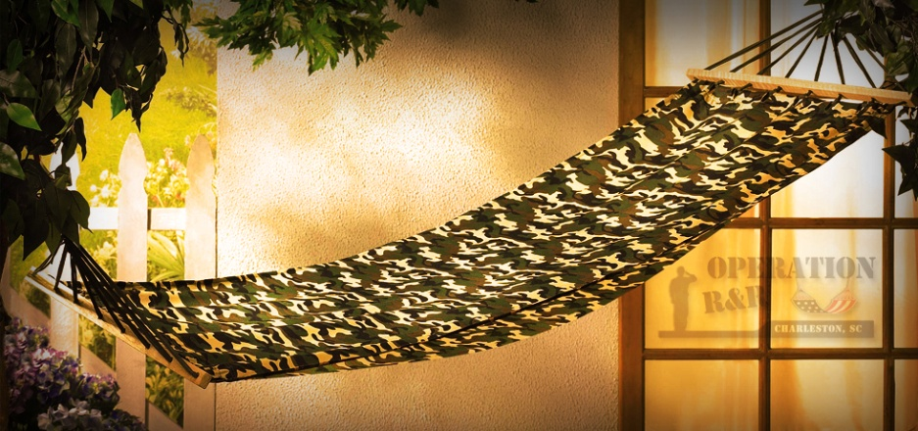
Operation Rest and Relax
Operation R&R is a non-profit organization designed to provide service men and women an opportunity to reconnect with their spouses and children upon their return from extended deployment.
http://www.youtube.com/watch?v=Hb5om1aFcI4&feature=youtu.be
Notes:
Grant – give a brief overview of how the program got started (your story) and play the video.

Slide 10
Program Successes
Hilton Head Island:
15 management companies & over 400 property owners.
60 restaurants and 35 service-related businesses (water sports, bike rentals, tours, spas, etc.) offering discounts of 50% or more.
Over 700 military families in 3 years have enjoyed the program and what it provides them in easing the process of reintegrating after deployment.
Notes:
Grant – summary of what you have accomplished in the past 3 years. Play video

Slide 11
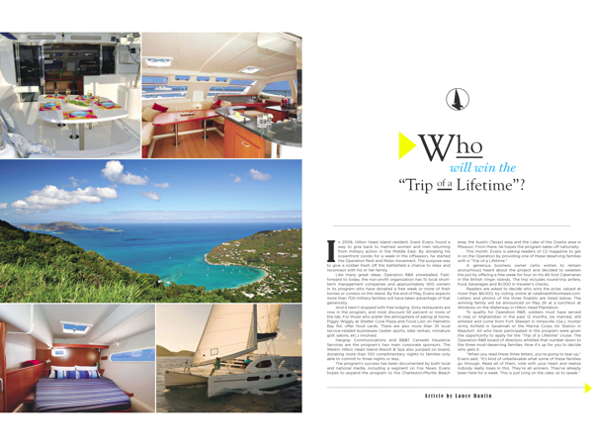
Media Attention
http://www.youtube.com/watch?v=WXIj1oLCd9g
http://www.wtoc.com/Global/story.asp?S=14166641
Notes:
Grant – introduce videos in the context of how a small, grassroots movement is gaining national attention…

Slide 12
National Expansion
The program’s success has been documented by both local and national media. As a result, plans are in progress to expand the program to other areas across the country with a goal of matching every military installation with a regional Operation R&R affiliate. The first expansion areas identified include Austin, Texas and Charleston, South Carolina.
Operation Rest and Relax USA, Inc. has been established as a non-profit corporation and will support the expansion efforts while headquartered in Charleston, SC.
Notes:
Grant – Talk a few minutes about how ORRUSA began

Slide 13
Operation R&R USA
Mission Statement:
Operation R&R is a National, non-profit organization dedicated to helping military families of service men and women, deal with the problems of reintegration and in easing post deployment stress. This is accomplished by providing a complimentary weeks vacation in donated rental properties at various "affiliate" locations, to provide these deserving military families the opportunity to "reconnect" with their loved ones at little or no cost.
National Headquarters and Leadership Team:
To be both a resource and an advocate for Operation R&R Regional Affiliates as they provide recreational and reintegration opportunities for service men and women returning from long deployments and to assist with the healing process of families of fallen service members.
Operation R&R USA serves as the umbrella organization to support our regional affiliates, which fosters emotional well-being and strengthens relationships through family vacations.
Notes:
Grant – share our mission

Slide 14
Operation R&R USA
Vision:
The Vision for Operation R&R, USA is to expand our efforts in dealing with the continuing issues that military men and women go through in regards to post deployment stress issues. We are currently expanding the benefits of the Operation R&R Program to the spouse and children of our "Fallen Heroes". We expect to have 4 affiliate Operation R&R locations fully operational by the end of 2011. Our long range goals are to continue to strategically expand and introduce 3-5 new affiliate locations per year as we continue to establish ourselves as the #1 provider of military family vacations nationally.
Vision Process:
To cultivate a nationwide network of regional affiliates with the goal of matching every military installation that has deployed personnel with a regional Operation R&R affiliate
To provide the resources necessary to serve families of fallen soldiers in the Operation R&R program.
Notes:
Grant – share our vision

Slide 15
Operation R&R USA
Services:
Program launch
Training
On-going support and consultation services
Operation R&R model materials and publications
Application and Reservation Software (in development)
National leadership
Fundraising, marketing, and media support
Military integration
Community Relations support
Notes:
Grant – discuss very briefly the services ORRUSA provides, then introduce Susan to discuss affiliate program

Slide 16
Operation R&R USA
Affiliate Development:
Goal – to establish a regional affiliate within a 4 hour drive of every US military installation that sends troops on extended deployments.
Organization - Regional organizations are chartered by Operation R&R USA.
The Affiliate Agreement outlines the responsibilities of a chartered regional organization and Operation R&R USA.
Regional organizations agree to fully implement the Operation R&R Model and participate in implementation training.
Regional Affiliates are legal entities operating as a non-profit corporation and led by an elected board of directors.
Notes:
Susan – introduce the regional affiliate program

Slide 17
Operation R&R USA
Steps for Success:
Set goals, assign tasks, and have fun!
Share the program – web, social media, press
http://operationrestandrelax.org/
http://operationrandrcharleston.org/
http://www.facebook.com/#!/pages/Operation-RR-Charleston/135747583166823
http://www.live5news.com/category/195958/video-landing-page?autoStart=true&topVideoCatNo=default&clipId=6032822
Seek help from ORR USA as needed, we are here to help our affiliates succeed but this is YOUR organization!
The key to a successful affiliate
is community ownership
Notes:
Susan, share a little about existing affiliates and get them excited, introduce Brian to discuss military relations and fallen hero program

Slide 18
Operation R&R USA
The Military Perspective:
Facts:
More and more Service Members entering the Military are married with children, large increase since 9/11.
Most Military Families can not afford to go on a 7 day vacation.
The Military does a great job at taking care of the single service member, but not a great job at taking care of the married. Perception vs reality.
Military Reintegration Policies do some counseling / Training but it is not enough.
Notes:
Brian -

Slide 19
Operation R&R USA
Facts:
The divorce rate in the Military has more than doubled since the start of OEF.
Example (US Army): fewer than 5000 in 2001, over 9,000 last year!
Across all services suicides are way up!...more than 15% of all Service Member suicides are married.
What Can We Do?!
Do you want to be part
of the solution?
Notes:
Brian -

Slide 20
Operation R&R USA
Military Partnerships:
We assist you on the your supporting installation (s).
Gain Access to the Chain of Command starting with the Commanding General of each installation
Help with Press releases on each installation
Assistance in getting to Family Support groups
We liaison with the supported installation for community relations events
Parades
Installation tours for supporting organizations
Guest speakers at events
Notes:
Brian -

Slide 21
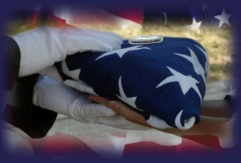
Families of Fallen Hero’s Program

Slide 22
Program Overview
The leadership of Operation R and R, USA identified a need to further support given to surviving Family members of service members killed in the line of duty during over seas deployments. Recognizing the unique challenges these Families now face, it was determined to expand the current construct of Operation R and R, USA to include a special part of Operation R and R, USA known as “Families of Fallen Hero's Program”.

Slide 23
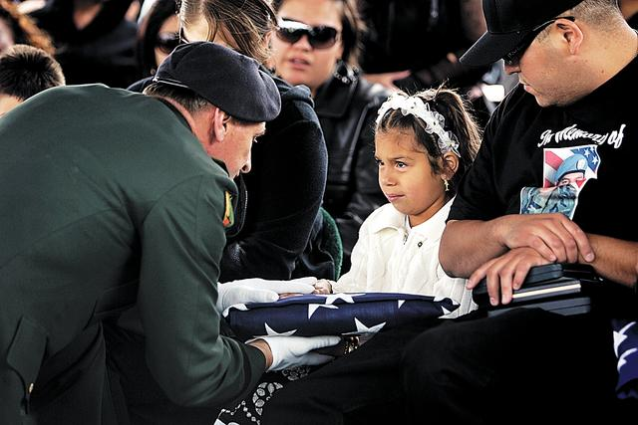
The Families in Need
Rest and Relaxation is every bit as needed with a Family who has lost a loved one.
Time to Heal
Time to bond
Time to try to make sense of it all
Regardless of when the sacrifice was made, these families need time away.
This is where our program can help

Slide 24
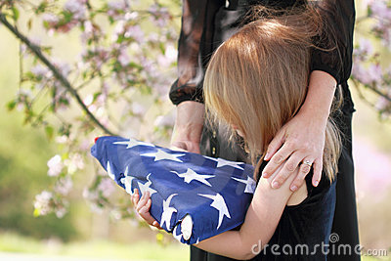
What the Program Will Do
This program is control by the National headquarters.
We plan to conduct an outreach program to let the Families of Fallen Hero’s know about our program.
If they choose, they will register on the National web site, and the registration is forward to the Program Director.
With in 48 hours initial contact with the family is made.
During the initial contact a survey form is filled out to fully understand the desires of the Family and discuss this program with them.

Slide 25
What the Program Will Do
Once the destination and time are agreed upon, the coordination with the affect affiliate or with the destination of choice will begin.
Once all coordination is complete, the family will take part in its Operation R and R, USA sponsored trip.
This trip will be at no cost to the family, and completely sponsored by private donations and the National Office

Slide 26
Destinations
We are in the process of developing a list of ‘Destinations of Choice’ for this program.
These will be private areas that may or may not participate with an affiliate, who wants only to help the Families of the Fallen.
All active affiliates will be in the program, and the Families of the Fallen will take precedence over Soldiers who are conducting normal Operation R and R vacations.

Slide 27
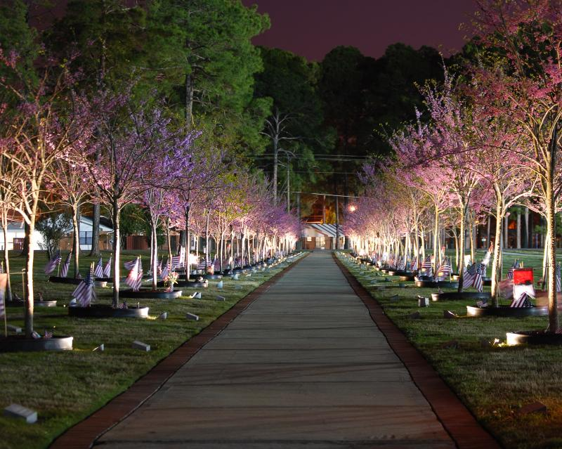
Funding / Timing
Funding for this Program will come from two areas, Private donations made specifically for sponsorships of Families of the Fallen and Operation R and R National Funds.
The importance of this program and integrating it into Operation R and R, USA will be expressed to every corporate donor……
This program will kick of in January 2012. Initial plan will be at least one Family a month, more if funding allows.
We will not forget the Fallen!

Slide 28
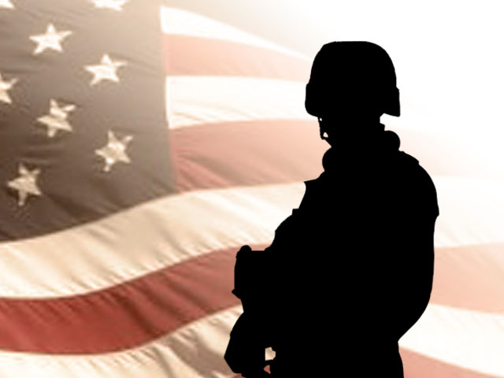
Operation R&R Supporting our Military Families
http://www.youtube.com/watch?v=MPtONDMA4-w&NR=1

Slide 29
Strategic Plan

