Slide 1
Suicide in the military
Prevalence, research, and resources
Daniel S. DeBrule, Ph.D.
Assistant Professor, Indiana University South Bend
Licensed Clinical Psychologist, Feathergill & Associates
Project Director, Alice Swarm Fund for Severe Mental Illness

Slide 2
Alice Swarm Fund
Goals
Enhance Mental Health in Michiana
  Sponsored Numerous Talks on Suicide
  Thomas Joiner: Workshop in South Bend 10/4
  Presentations/Suicide Prevention Statewide
Support University Research
  Current Research Regarding Posttraumatic Growth in Veterans, Writing in Veterans with Psychosis, Suicidal Thinking & Behavior, Writing Interventions for Trauma
Assist with Course & Training Dissemination
  Rare, yet very relevant and seemingly necessary
  Assessing & Managing Suicide Risk for VA providers

Slide 3
Background
Trained at 3 VA hospitals
Created manualized writing treatment for PTSD in VA setting
Experience in group & individual psychotherapy with veterans
Specialize in trauma (PTSD) & suicide

Slide 4
Todays Presentation
Discuss the trends in suicide and specific findings among military populations
Outline several common theories for suicide
Explain how theories may be relevant to veterans
Provide Helpful Tips for Assessing & Treating Suicidal Thinking & Potential for Suicidal Behavior
With appreciation to J. McIntosh & T. Joiner
for specific material presented

Slide 5
More help is on the way…..
More representation for the issue in recent times in military & government
All VA medical centers mandated to have full-time suicide prevention coordinator
Craig Bryan & David Rudd
  Current research on interventions for veterans who are suicidal
Thomas Joiner & Pete Gutierrez
  18 million project across 3 years examining suicide in the military
Army STARS project
  50 million dollars devoted to understanding demography of suicide in veterans

Slide 6
Annual Number of
USA Suicides
2007
34,598
2006
33,300
more than
2005
32,637
2004
34,000
31,439
2003
currently
31,484
2007 data
Notes:
In order to put suicide into perspective, it might help to know that:
There are approximately 34,000 suicides annually at the present time (34,598 in 2007).
The number of suicides in each of the last 5 years were the highest ever recorded since 1900 (with 2007 the highest total ever).
Additional information about the American Association of Suicidology may be obtained by visiting the official website at:
http://www.suicidology.org
Or by writing to the association at: 5221 Wisconsin Avenue, N.W., Washington, DC 20015
Or by calling (202) 237-2280 [FAX (202) 237-2282]
Or by email at info@suicidology.org
Other statistical information may be found at Dr. McIntosh’s website:
http://mypage.iusb.edu/~jmcintos
Comments about or suggestions for new overheads may be directed to Dr. McIntosh at:
Academic Affairs, Indiana University South Bend
P.O. Box 7111, South Bend, IN 46634-7111
Or jmcintos@iusb.edu

Slide 7

Timing of USA Suicides
1 suicide
every 15
minutes …
15.2
12:15 …
12:30 …
12:45…
Notes:
A number like 34,000 (or 34,598) is difficult to make meaningful, so looking at it in another way,
On the average, a suicide occurs every 15 minutes — 24 hours per day, 7 days per week, 365 days per year.
[You might find it useful to point out that “in the time everyone was seated, introductions were made, etc., (on the average) a person somewhere in the USA died by their own hand,” and/or “in the time we will be here today X people therefore will have died by suicide”]
Calculation: [365 days X 24 hrs/day X 60 min/hr = 525,600 min/yr] divided by no. of suicides (34,598) = 1 suicide every x min. (1 every 15.2 min. in 2007)

Slide 8

Timing of USA Suicides
95 Suicides
each day
75 men
20 women
Notes:
Still another way to understand the frequency of suicide,
On the average, 95 individuals die by suicide each day; 75 of them men, 20 of them women — each of the days each year.
[the AAS statistics sheet provides other data for number per day, etc. for other demographic groups (young, old, white, nonwhite, etc.)] [This datasheet may be obtained by downloading it from either AAS’s or Dr. McIntosh’s websites]
AAS: www.suicidology.org
McIntosh: mypage.iusb.edu/~jmcintos Then click on “Recent Suicide
Statistics”. This link displays the information at a webpage and
provides a link for a PDF version of the page at:
http://mypage.iusb.edu/~jmcintos/usa2007summary.htm

Slide 9
Suicide - Leading Cause of Death
Rank
Cause of Death
Rate
Deaths
1
Diseases of the heart (heart disease)
204.3
616,067
2
Malignant Neoplasms (cancer)
186.6
562,875
3
Cerebrovascular diseases (stroke)
45.1
135,952
4
Chronic lower respiratory diseases
42.4
127,924
5
Accidents (unintentional injuries)
41.0
123,706
6
Alzheimer’s disease
24.7
74,632
7
Diabetes mellitus (diabetes)
23.7
71,382
8
Influenza & pneumonia
17.5
52,717
8
9
Nephritis, nephrosis (kidney disease)
15.4
46,448
10
Septicemia
11.5
34,828
Suicide
11.5
34,598
11
Suicide (intentional self-harm)
11th ranking cause
Rate=803.6
11
2,423,712 Total Deaths
Notes:
A final dimension to put suicide into perspective is to recognize where suicide ranks among the causes of death
Suicide is currently the 11th leading cause of death in the USA.
That is, Americans only die from 10 causes more often than suicide.
Among the higher ranking causes, few are as preventable as suicide - we know the warning signs, trained mental health professionals and crisis intervention centers are available to intervene.
Suicide dropped to the 11th ranking in 1999 (and remains there each year through 2007) after being ranked in the top 10 causes of death in the U.S.A. every year since 1975. This represented a drop from 8th in 1998. The drop in ranking results from declines in suicide numbers and rates throughout nearly all of the 1990s but in large part due to the change starting with 1999 to a new revision of the international classification system for mortality (ICD-10). A fuller explanation of this change may be found at: http://www.iusb.edu/~jmcintos/rankexplained.doc
Suicide ranks above homicide (see Slides 6 and 7).

Slide 10
More Americans Die by Suicide Each Year Than by Homicide
Suicide 34,598
11th ranking cause
11.5 per 100,000
Homicide 18,361
15th ranking cause
6.1 per 100,000
88% more people killed themselves than were murdered by others
Notes:
Suicide ranks higher than homicide (11th vs. 15th).
As these numbers show, 88% (88.4%) more people killed themselves than were murdered in 2007.
See Slide 7 for the long-term perspective of this comparison.

Slide 11
Causes of Death by Sex in USA
Ranks higher for men, lower for women
Men
Women
Rank & Cause of Death
1. Diseases of heart
2. Malignant neoplasms
3. Accidents (unintentional injuries)
4. Chronic lower respiratory diseases
5. Cerebrovascular diseases
6. Diabetes mellitus
7. Suicide (intentional self-harm)
8. Influenza & pneumonia
9. Nephritis & Nephrosis
10. Alzheimer’s disease
Deaths
309,821
292,857
79,827
61,235
54,111
35,478
27,269
24,071
22,616
21,800
Rank & Cause of Death
1. Diseases of heart
2. Malignant neoplasms
3. Cerebrovascular diseases
4. Chronic lower respiratory diseases
5. Alzheimer’s disease
6. Accidents (unintentional injuries)
7. Diabetes mellitus
8. Influenza & pneumonia
9. Nephritis & Nephrosis
10. Septicemia
11. Hypertension
12. Chronic liver disease & cirrhosis
13. Parkinson’s disease
14. Pneumonitis due to solids and liquids
15. Suicide (intentional self-harm)
Deaths
306,246
270,0189
81,841
66,689
52,832
43,879
35,904
28,646
23,832
18,989
14,548
10,014
8,504
8,054
7,329
1,203, 968
total deaths
7th cause for men
15th cause for women
1,219,744 total deaths
Notes:
Suicide ranks 11th for the nation as a whole (Slide 5),
Suicide ranks higher among men - 7th
Suicide ranks lower among women - 15th

Slide 12



Sex/Gender & Suicide Methods
Firearms the leading method for Men
Women used poisons most then firearms
Men
Women
Firearms 55.7% 15,181 29.6% 2,171
Suffocation incl. hanging, strangulation 24.4% 6,649 20.6% 1,512
Poisoning (solid and liquid and gas) 12.5% 3,413 40.2% 2,945
All Other Methods 7.4% 2,026 9.6% 701
Total Number
27,269
7,329
Note: Totals may not equal 100% due to rounding
Notes:
Regarding method choices by men and women in their deaths by suicide:
For many years, both men and women have used firearms most often in their suicides. By 2003, however, while men continued to use firearms as the leading method, changes in proportions have resulted in firearms ranking lower than poisons among women. This continued from 2004 through 2007.
Men’s second most common choice is Hanging (includes strangulation and suffocation, though the overwhelming majority in this category are by hanging); men rarely use poisons.
[see also Slide 57 which shows trends over time in firearms by gender; Slide 56 shows overall trends in firearms over time]

Slide 13
Divisional Differences in USA Suicide
Suicide highest in the Mountain States
Mountain
West North Central
East North Central
8.5
Pacific
9.3
11.0
Middle Atlantic
12.3
New England
16.8
10.9
South Atlantic
12.1
13.8
National Rate
11.2
11.5
East South Central
per 100,000 population
West South Central
Notes:
Geographic distributions of suicide show a clear high risk area of the country.
Suicide is consistently highest in the mountain division of the western USA.
Regional distributions are portrayed in Slide 72. Slide 73 portrays the suicide rates with individual state coding according to categorical ranges of suicide rates, while Slide 74 provides the individual suicide rates for each state.
It is important to utilize suicide RATES in such comparisons to take into account the varying number of individuals contributing to the deaths - suicide rates will be used widely hereafter - rate = number of suicides divided by the number of individuals in the group, with this result multiplied by a constant of 100,000 - therefore the suicide rate gives the number of individuals in each unit of 100,000 population for that group who died by suicide in a particular time period - thus, for every unit of 100,000 Americans during 2007, about 11 (rate=11.5) of them died by suicide.
Consult http://mypage.iusb.edu/~jmcintos for further state and regional data across time (from 1990 to 2007 currently).
State data may also be found at CDC’s WISQARS website (www.cdc.gov).

Slide 14
USA State Suicide Rates
Ranking of Top States
15
14
1 Alaska
2 Montana
3 New Mexico
4 Wyoming
5 Nevada
2
11
9
11
4
5
15
6
7
10
6 Colorado
7 West Virginia
8 Arizona
9 Oregon
10 Kentucky
8
3
13
1
Notes:
The top 10 states in suicide rates (risk) largely reflect the geographic distribution seen in Slide 16.
Nearly all of the Mountain division’s states are in the top 10 and all are among the highest ranked almost every year.
(remember that low rankings are associated with higher rates)
Caution should be taken when comparing states and their rankings/rates in any single year - annual fluctuations can dramatically affect the resultant rates, particularly in states with lower populations. As one example, Vermont ranked in a tie for 26th in 2001, but in 2002 it ranked 10th and then dropped to 16th in 2003, but up to 12th in 2004 and then down again to tied for 22nd in 2005. The number of suicides increased from 72 to 92 and then declined to 83 and then up to 93 and down to 78 (and the rate fluctuated from 11.7 to 14.9 to 13.4 to 15.0 to 12.5) in just that period of five years from 2001 to 2005. In the other direction, Maine was 20th in 2002 but dropped to 36th in 2003 following a drop of only 29 deaths by suicide (166 to 137; and a rate drop from 12.8 to 10.5). In 2004 there were 171 suicides for a rate of 13.0 and a ranking of 21st but in 2005 the 175 suicides and 13.2 rate led to a ranking of a tie for 18th. In 2006, Maine ranked 28th with 158 suicides and a rate of 12.0. A final example was the 6th ranking for South Dakota in 2006 with 125 suicides but a drop to a tie for 25th in 2007 with 102 suicides.
Slide 73 provides the same basic information as this slide, but adds color coding by ranges of rates of suicide for each state (rather than the divisions that are color coded in the present slide). Slide 74 shows the specific suicide rates for each state.
Slide 75 provides state differences for suicide among youth aged 15-24 years while Slide 76 provides state differences for suicide among older adults (65 and above).

Slide 15
USA Suicide by Sex/Gender
Nearly 4 times more men die by
suicide than women
27,269
18.3
Men
7,329
Women
4.8
Number of Suicides
Suicide Rates
Notes:
The most powerful demographic predictor of suicide is the sex or gender of the individual.
Males kill themselves much more often than do women (both in number and as measured by rates).
Not only do nearly 4 times more men kill themselves than women, but as measured by rates, the risk of suicide is also nearly 4 times that for women.
The ratio of male suicides to female suicides in 2006 was 3.7 to 1 (and the ratio/difference has mostly increased over the last two decades; men’s suicides and rates have increased while women’s have mostly been stable - though both men and women have shown declines in rates from the 1990s through 2003, with slightly higher 2004 through 2007 rates). See Slide 45 for a graph of men’s and women’s suicide rates over time (1933 to 2007).

Slide 16

USA Suicide by Race & Sex
White men have highest rates
White Men
20.5
24,725
Nonwhite Men
9.6
2,544
White Women
5.4
6,623
Nonwhite Women
2.3
706
Rate
Rate per 100,000 population
Number
Notes:
Racial differences are most accurately shown by looking at race and sex simultaneously.
Men of all races are at higher risk than women.
Whites are at higher risk within each gender than their nonwhite counterparts. [see Slide 47 for trends over time by race and gender]
While the ratio of white to nonwhite rates overall is more than 2 to 1 (2.3 in 2007), the ratio of white men to nonwhite men is 2.1 to 1 and 2.3 to 1 for white women to nonwhite women [see Slide 58]

Slide 17
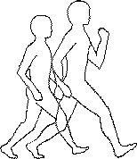

USA Suicide by Age
Rates generally increase with age
Tendency to bimodal pattern
Middle-Aged rise in relative overall risk in last two years
10-yr age group data
Notes:
Suicide rates generally increase with age, with peaks typically in late life (after age 65). 2007 is the second consecutive year in which a middle-aged group (45-54 yrs) has exceeded all over-65 age groups (whether this is an anomaly or a new pattern remains to be seen; it is primarily produced by the decline in rates in late life with small increases in midlife and reflects the combined pattern for men and women – e.g., men’s rates are highest at ages 75-84 and 85 and above).
An even more distinct increase with age was prominent several decades ago. However, increases in suicide among those groups under age 45 and decreases among the old have lessened age differences and nearly flattened the rates of suicide from young adulthood through middle adulthood (see Slides 59-64 for some comparisons and figures showing the dramatic changes in age and suicide in recent years).
In fact, the USA rates by age have over the years moved toward a bimodal pattern, with an initial peak in early middle adulthood currently, followed by slightly lower rates during late middle adulthood period and early late life and then increases to another peak in late adulthood.
Suicide rates by age vary greatly, however, especially with sex and race/ethnicity (see Slides 23, 24, 25 and 65-70).

Slide 18
USA Suicide & Ethnicity
Suicide Rates 2007
Although the number of
suicides is overwhelmingly
White, as is the U.S.
population, the risk of suicide
(i.e., the rate) shows wide
variability for specific ethnic
groups
African American
4.9
Hispanic*
5.4
Asian &
Pacific Islander
6.1
NATION
11.5
Native American
12.1
White
12.9
Rate per 100,000 population
* Hispanics may be of any race
Notes:
Rates of suicide by ethnicity show
• As in most years, in 2007 Whites displayed the highest rates (see Slide 24); Native Americans rates were higher in 2004 and again slightly in 2005, but slightly lower in 2006 and lower still in 2007.
• There is wide variability, not homogeneity, among racial/ethnic groups in suicide risk.
Note: These figures represent figures for a single year. In the case of some groups, rates are based on relatively low numbers of deaths and are therefore subject to potentially large variation with the increase or decrease of only a few deaths. It would be preferable to use multi-year to single-year data (see e.g., Slides 68-70).

Slide 19
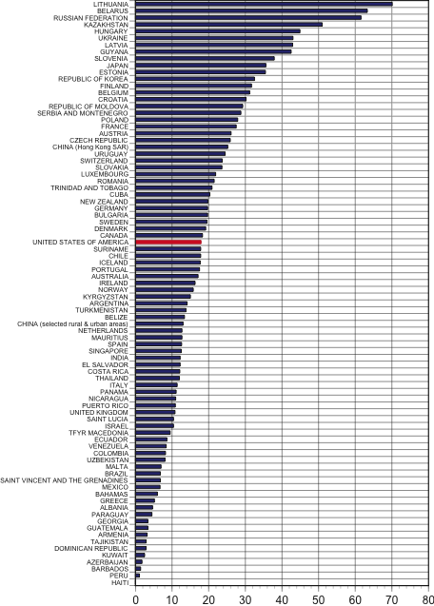
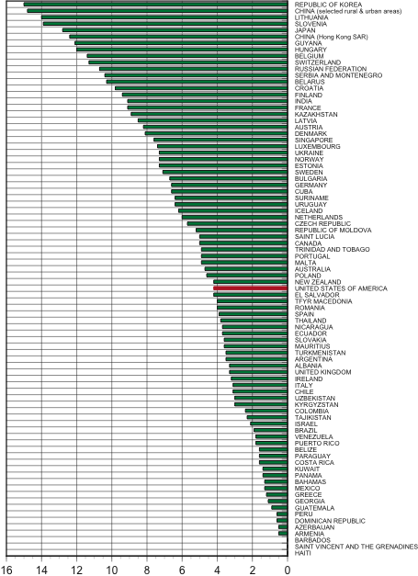

International Comparisons
USA
USA
Men
Women
USA has moderate suicide rates
Data from
World Health
Organization
Notes:
The USA is not among those countries with the highest rates of suicide.
USA suicide is at moderate levels worldwide for both men and women.
Data source: Most recent year posted at the World Health Organization Statistical Information System website on February 1, 2008. The data, the most recent as of 2007 according to the website, include figures for slightly more than 100 nations. Of the slightly more than 100 nations for which data appeared in the posted table, only those for which data since 1996 were the latest reported were included; most data were from 2002-2004, with a few earlier and a small number for 2005.
At the WHO website for Suicide Prevention (SUPRE) http://www.who.int/mental_health/prevention/suicide/suicideprevent/en/index.html is a figure coded for suicide rates across the world.
Additional sources for international suicide data may be found in:
De Leo, D., & Evans, R. (2004). International Suicide Rates and Prevention Strategies. Cambridge, MA: Hogrefe & Huber.
Schmidtke, A., Bille-Brahe, U., De Leo, D., & Kerkhof, A. (Eds.). (2004). Suicidal Behaviour in Europe: Results from the WHO/EURO Multicentre Study of Suicidal Behaviour. Cambridge, MA: Hogrefe & Huber.

Slide 20
Attempted Suicides (Nonfatal Outcomes)
Estimated that there are
25 attempted suicides for each
death by suicide
SAMSHA (2009)
1.1 million adults
Suicide
Attempted Suicides
Moscicki et al.
Ratio implies 864,950 suicide attempts in USA in 2007
Notes:
Changing focus to attempted suicides, acts that end nonfatally, [aka parasuicide and deliberate self harm]
There are no official national USA statistics available. Thus, estimates based on research findings are utilized to determine the numbers that occur.
Based on these epidemiological investigations, it is estimated that there are 25 attempted suicides for each death by suicide (based on results from an Epidemiological Catchment Study conducted by the National Institutes of Mental Health; see below).
Therefore, the 34,598 suicides in 2007 translate to 864,950 attempts annually (a number considered conservative by many in the field).
Moscicki, E.K., O’Carroll, P.W., Rae, D.S., Roy, A.G., Locke, B.Z., & Regier, D.A. (1989). Suicide ideation and attempts: The Epidemiologic Catchment Area Study. In M.L. Rosenberg & K. Baer (Eds.), Report of the Secretary’s Task Force on Youth Suicide, Vol. 4: Strategies for the prevention of youth suicide (pp. 4-115 - 4-128). DHHS Pub. No. (ADM) 89-1624. Washington, DC: USGPO. [see p. 4-126: “300 per 100,000 persons each year attempt suicide”; which can be compared to a general suicide rate of 12 per 100,000]
Based on a more recent epidemiological investigation, it is estimated that there are 36 (based on 14 suicides per 100,000) to 45 (based on 11 suicides per 100,000) attempted suicides for each death by suicide (based on results from Kessler et al., 2005; see below).
Therefore, the 334,598 suicides in 2007 would translate from 1,245,000 to 1,557,000 attempts annually.
Kessler, R.C., Berglund, P., Borges, G., Nock, M., & Wang, P.S.. (2005). Trends in suicide ideation, plans, gestures, and attempts in the United States, 1990-1992 to 2001-2003: JAMA, 293, 2487-2495. [see p2493: “500 suicide attempters per 100,000 population in the United States each year”; which can be compared to a general suicide rate of 11 currently (or cited as 14 per 100,000 in the article]
A 2009 study by SAMHSA estimated that there were 1.1 million attempts among adults (aged 18 and above) in the past year ( www.samhsa.gov/newsroom/advisories/090917suicide0907.aspx ). The study additionally estimated that 8.3 million adults had seriously thought about killing themselves in the past year while 2.3 million had made a suicide plan. [The full report may be found at http://oas.samhsa.gov/2k9/165/suicide.cfm ]

Slide 21

Attempted Suicides (Nonfatal Outcomes)
Annually, there are an estimated
> 850,000 attempted suicides
1 every 38
seconds
SAMSHA (2009)
1.1 million adults
1 every 29 sec
25:1 Ratio implies 864,950 suicide attempts in USA in 2007
Ratio implies 2,281 per day; 1 every 38 seconds
Notes:
Focusing on attempted suicides, acts that end nonfatally, [aka parasuicide and deliberate self harm],
There are no official national USA statistics available. Thus, estimates based on research findings are utilized to determine the numbers that occur.
Based on these epidemiological investigations, as noted in Slide 32, it is estimated that there are 25 attempted suicides for each death by suicide (based on results from an Epidemiological Catchment Study conducted by the National Institutes of Mental Health; see below).
Therefore, the 34,598 suicides in 2007 translate to 864,950 attempts annually (a number considered conservative by many in the field). By this estimate this would mean that there are 2,281 attempted suicides each day or 1 nonfatal suicidal act every 38 seconds. The higher SAMSHA adult estimate would yield an adult attempt every 29 seconds.
Moscicki, E.K., O’Carroll, P.W., Rae, D.S., Roy, A.G., Locke, B.Z., & Regier, D.A. (1989). Suicide ideation and attempts: The Epidemiologic Catchment Area Study. In M.L. Rosenberg & K. Baer (Eds.), Report of the Secretary’s Task Force on Youth Suicide, Vol. 4: Strategies for the prevention of youth suicide (pp. 4-115 - 4-128). DHHS Pub. No. (ADM) 89-1624. Washington, DC: USGPO. [see p. 4-126: “300 per 100,000 persons each year attempt suicide”; which can be compared to a general suicide rate of 12 per 100,000]
2009 study by SAMHSA www.samhsa.gov/newsroom/advisories/090917suicide0907. [The full report may be found at http://oas.samhsa.gov/2k9/165/suicide.cfm ]
NEW SLIDE for 2007 slide set.

Slide 22
Attempted Suicide -
Sex/Gender
Estimates are that there are
3 women who attempt
for each man who
attempts
Notes:
Unlike suicide, the highest risk for suicide attempts is found for women.
The ratio of women’s attempts to men’s is estimated to be 3 to 1 (nearly the reverse of the ratio of male to female suicide deaths).

Slide 23
In the typical high school classroom...
1 male and 2 females have probably attempted suicide in the past year
Source: King (1997, p. 66)
Notes:
Based on a review of the literature, Cheryl King (1997) made the following statements:
“These percentages [of high school students who have attempted suicide in the past year] take on more meaning when considered within an environmental context. They suggest that in a typical high school classroom, it is probable that one boy and two girls have made a suicide attempt during the past year.” (p. 66)
Source:
King, Cheryl A. (1997). Suicidal behavior in adolescence. In Ronald W. Maris, Morton M. Silverman, & Silvia S. Canetto (Eds.), Review of suicidology, 1997 (pp. 61-95). New York: Guilford Press.
The YRBS results (2005 data portrayed in the next 2 slides) show that in a 2005 sample, 6.0% of high school boys and 10.8% of girls had attempted suicide in the 12 months preceding the survey.
Thus, in a 40 student classroom of 20 boys and 20 girls, 1 boy and 2 girls would, on average, have attempted suicide in the past year.

Slide 24
Number of Suicide Survivors
It is Estimated that there are
6 survivors
for each death by suicide
Suicide’s
Aftermath
A
“suicide survivor”
is someone who
has lost a loved
one to death by
suicide
Ratio implies 207,588 survivors in 2007
Notes:
A third, often neglected, dimension of suicidal behavior, involves those who remain after a suicide has occurred, a group referred to as “survivors of suicide.”
No systematic epidemiological investigations exist to determine the number of survivors, but it has been estimated in the literature that there are at least 6 survivors for each suicide that takes place. (Using this estimate, the 34,598 suicides in 2007 would translate to 207,588 survivors.)
This figure originally appeared in a small volume that resulted from the first annual conference of the AAS in Chicago in 1968:
Shneidman, Edwin S. (1969). Prologue: Fifty-eight years. In E.S. Shneidman (Ed.), On the nature of suicide (pp. 1-30). San Francisco: Jossey-Bass.
Shneidman said there: “…for each committed suicide there are an estimated half-dozen survivor-victims whose lives are thereafter benighted by that event.” (p. 22)

Slide 25
General Conclusions
We need to worry about certain groups at risk, but not ignore those who typically are not
Means Restriction is a powerful means of suicide prevention
Adults, especially the elderly, are very serious relative to suicidal behavior, but teens attempt at high rates & be vulnerable
This is a serious culprit of human life, but often not discussed or addressed even in health care setting

Slide 26
Suicide Rates in the Military
Rates have steadily increased over the past decade
Half use a weapon, over 90% if in combat theatre
30% actually are never deployed
In 2009, 98 suicides and over 1800 attempts
Rate per 100K vary widely, some finding as high as 20-17, whereas national average is 11.5 and for young adult males 14-17
PTSD can increase risk sixfold

Slide 27
Suicide Risk & Resources in the Military
Early in OIF, anecdotal evidence of suicide & treatment barriers
Alcohol and Prescription Drugs increase risk in veterans
Army has revised suicide prevention pamphlet
A number of task forces and initiatives have been implemented
Additional training very important
1-800-273-TALK may be invaluable
  The follow-up with veterans

Slide 28
Theories of Suicidal Behavior

Slide 29
Durkhiem
Wrote Le Suicide (1897)
First to use statistics
Suicidology not a science until 1957
Posited Four Types
  Anomic
  Altruistic
  Egoistic
  Fatalistic (rare)

Slide 30
Past Theories
Shneidman on “psychache”
  Emphasized lethality and perturbation as key ingredients of serious suicidality
  Proposed a cubic model
    Press
    Pain (psychache)
    Perturbation
  Commonalities of Suicide
    Ambivalence
    Constriction
    Poor Coping

Slide 31
Past Theories
Beck on hopelessness
  Impressive data support this view; however, the model struggles somewhat with questions like “if hopelessness is key, why then do relatively few hopeless people die by suicide?”

Slide 32
The Interpersonal Theory of Suicide
Those Who
Desire Suicide
Perceived
Burdensomeness
Those Who Are Capable of Suicide
Thwarted
Belongingness
Serious Attempt or Death by Suicide

Slide 33
The Acquired Capability to Enact Lethal Self-Injury
“It seems rather absurd to say that Cato slew himself through weakness. None but a strong man can surmount the most powerful instinct of nature” – Voltaire.
Accrues with repeated and escalating experiences involving pain and provocation, such as
  Past suicidal behavior, but not only that…
  Repeated injuries (e.g., childhood physical abuse).
  Repeated witnessing of pain, violence, or injury (cf. physicians).
  Any repeated exposure to pain and provocation.

Slide 34
The Acquired Capability to Enact Lethal Self-Injury
With repeated exposure, one habituates – the “taboo” and prohibited quality of suicidal behavior diminishes, and so may the fear and pain associated with self-harm.
Relatedly, opponent-processes may be involved.

Slide 35
The Acquired Capability to Enact Lethal Self-Injury
Briefly, opponent process theory (Solomon, 1980) predicts that, with repetition, the effects of a provocative stimulus diminish…. habituation in other words.
BUT….

Slide 36
Speaking of skydiving
A woman once said that, the first time she went skydiving, her mind wanted to jump, but her grip on the side of the plane’s door would not loosen, and when her co-jumper literally pried her grip loose, her other hand latched on to the other side of the door, as if it had a mind of its own.

Slide 37
The Acquired Capability to Enact Lethal Self-Injury
Opponent process theory also predicts that, with repetition, the opposite effect, or opponent process, becomes amplified and strengthened.
Example of skydiving.

Slide 38
The Acquired Capability to Enact Lethal Self-Injury
The opponent process for suicidal people may be that they become more competent and fearless, and may even experience increasing reinforcement, with repeated practice at suicidal behavior.

Slide 39

Anecdotal Evidence: Pink
“I like putting holes in my body. It's addictive.” - Pink

Slide 40
Empirical Evidence
In a case-controlled study comparing accidental deaths to suicides, people who died by suicide were more likely to have tattoos (Dhossche, Snell, & Larder, 2000). There are many possible reasons for an association between tattooing and completed suicide (e.g., substance abuse). It is an intriguing if speculative interpretation, however, that eventual suicide victims have obtained courage regarding suicide partly via painful and provocative experiences, such as tattooing, piercing, etc.

Slide 41
Empirical Evidence
Lethality of method and seriousness of intent increase with attempts.
People who have experienced or witnessed violence or injury have higher rates of suicide – prostitutes, self-injecting drug abusers, people living in high-crime areas, physicians.
Those with a history of suicide attempt have higher pain tolerance than others.

Slide 42
Empirical Evidence: “Kitchen Sink”
The model predicts an association between past and future suicidality, even beyond strong covariates like mood disorder status, family history of psychopathology, etc..
In four samples (U.S. suicidal outpatients, Brazilian inpatients, U.S. college students, & U.S. geriatric inpatients), this prediction was supported.
Joiner et al. (2005). Journal of Abnormal Psychology.

Slide 43
Empirical Evidence: Childhood Physical/Sexual Abuse
The model predicts an association between childhood physical abuse and future suicidality, even beyond strong covariates like mood disorder status, family history of psychopathology, etc.
The model further predicts that this association will be stronger than that between verbal/emotional abuse and suicidality, because physical/sexual abuse involves more physical pain.

Slide 44
Empirical Evidence: Childhood Physical/Sexual Abuse
This is in fact the finding in the National Comorbidity Survey data set.
Childhood physical/sexual abuse predicts lifetime number of suicide attempts controlling for a host of strong covariates like personal and family psychopathology, and for verbal/emotional abuse.
Verbal/emotional abuse was not predictive of later suicidal behavior.
Joiner et al. (2006). Behaviour Research & Therapy.

Slide 45
The Documentary The Bridge
Photographer saves someone who is pondering jumping from the Golden Gate Bridge.
Here too, behavioral indicators of ambivalence.

Slide 46
      “In those days, people will seek death, and will in no way find it. They will desire to die, and death will flee from them.”
        Revelations 9:6.
Notes:
46

Slide 47
Intently Suicidal People Know Killing is Hard to Do
Many documented cases of people who take planful steps to prevent their bodies from reacting and saving them (e.g., binding hands before death by hanging).

Slide 48


Slide 49


Slide 50
Anecdotal Evidence: Cobain
Cobain was temperamentally fearful – afraid of needles, afraid of heights, and, crucially, afraid of guns. Through repeated exposure, a person initially afraid of needles, heights, and guns later became a daily self-injecting drug user, someone who climbed and dangled from 30 foot scaling during concerts, and someone who enjoyed shooting guns.

Slide 51
Anecdotal Evidence: Cobain
Regarding guns, Cobain initially felt that they were barbaric and wanted nothing to do with them; later he agreed to go with his friend to shoot guns but would not get out of the car; on later excursions, he got out of the car but would not touch the guns; and on still later trips, he agreed to let his friend show him how to aim and fire. He died by self-inflicted gunshot wound in 1994 at the age of 27.

Slide 52
Anecdotal Evidence: Fire Victim
“I wonder why all the ways I’ve tried to kill myself haven’t worked. I mean, I tried hanging; I used to have a noose tied to my closet pole. I’d go in there and slip the thing over my head and let my weight go, but every time I started to lose consciousness, I’d just stand up. I tried to take pills; I took 20 Advil one afternoon, but that just made me sleepy. And all the times I tried to cut my wrist, I could never cut deep enough. That’s the thing, your body tries to keep you alive no matter what you do (italics added).”

Slide 53
Anecdotal Evidence: Fire Victim
Later diary entries described how the narrator doused himself with gasoline and set himself on fire; he survived, badly burned (This American Life, National Public Radio, May 11, 2003).
This example illustrates Voltaire’s “most powerful instinct of nature” (i.e., “your body tries to keep you alive no matter what you do”), as well as the progression that allows people to do extreme things in attempting to overcome it (e.g., self-immolation).

Slide 54
Anecdotal Evidence: Meriwether Lewis (of Lewis & Clark fame)
From Stephen Ambrose’s biography of Lewis, Undaunted Courage:
  Lewis paced for several hours (agitation), as others could hear him all night as the floorboards creaked.
  Two self-inflicted gunshot wounds, neither fatal.
  Servants found him “busily cutting himself from head to foot.”
  Lewis said to servants, “I am no coward, but I am strong, it is so hard to die.” He died a few hours later.
Notes:
54

Slide 55
Autopsy Report: Hesitation Wounds
Death was from knife wound – homicide or suicide?
  “absence of hesitation wounds”
  “stabbing through clothing”
  long history of depression
  location and angle of wounds consistent with suicide
Notes:
55

Slide 56
Suicide in Anorexia Nervosa
Mortality is extremely high in anorexic women (SMR = ~60).
It is an under-appreciated fact that, should an anorexic patient die prematurely, the cause of death is more likely to be suicide than complications arising from compromised nutritional status.
Notes:
56

Slide 57
Suicide in Anorexia Nervosa
There are at least two possible accounts of the high association between AN and suicide. In one view, anorexic women die by suicide at high rates because they are unable to survive relatively low lethality attempts and/or they may be less likely to be rescued after an attempt due to their socially isolated status.
Notes:
57

Slide 58
Suicide in Anorexia Nervosa
In another view, informed by my theory of suicidal behavior, anorexic women die by suicide at high rates because their histories of self-starvation habituate them to pain and inure them to fear of death, and they therefore make high lethality attempts with high intent-to-die.
Notes:
58

Slide 59
Suicide in Anorexia Nervosa
One study pitted these two accounts against each other, in a study of 239 women with AN, followed over ~15 years.
9 died by suicide, the leading cause of death among the sample.
Of these 9, were they mostly highly lethal methods or not?
Notes:
59

Slide 60
Suicide in Anorexia Nervosa
The least lethal method: Ingestion of 12 oz. of a household cleaning product, along with an unknown amount of a powerful sedative and alcohol (BAC = 0.16%). Cause of death was gastric hemorrhaging due to hydrochloric acid in the cleaning product.
  She called 911 immediately after ingestion.
  Might Bitrix have prevented this?
Notes:
60

Slide 61
Fearlessness vs. Heroism
Compare the actions of the person who ingested the cleaning agent to the actions of those on United flight 93 on 9/11.
Notes:
61

Slide 62
Summary of Acquired Capability
Tremendously relevant to veterans
  Fearlessness
  Pain Tolerance
  Repeated exposure to painful and/or provocative events
  All elements of training
Notes:
62

Slide 63
Those Who
Desire Suicide
Perceived
Burdensomeness
Those Who Are Capable of Suicide
Thwarted
Belongingness
Serious Attempt or Death by Suicide
Notes:
63

Slide 64
Constituents of the Desire for Death
Perceived Burdensomeness
Thwarted Belongingness
Notes:
64

Slide 65
Perceived Burdensomeness
Essential calculation: “My death is worth more than my life to my loved ones/family/society.”
Notes:
65

Slide 66
Perceived Burdensomeness: Empirical Evidence
Other research too has supported this link.
  For example, Brown, Comtois, & Linehan (2000) reported that genuine suicide attempts were often characterized by a desire to make others better off, whereas non-suicidal self-injury was often characterized by desires to express anger or punish oneself.
  Brown, M.Z., Comtois, K.A., & Linehan, M.M. (2002). Reasons for suicide attempts and nonsuicidal self-injury in women with borderline personality disorder. Journal of Abnormal Psychology, 111, 198-202.

Slide 67
Perceived Burdensomeness: Anecdotal Evidence
Burn victim mentioned earlier: "I felt my mind slip back into the same pattern of thinking I'd had when I was fourteen [when he attempted suicide]. I hate myself. I'm terrible. I'm not good at anything. There's no point in me hanging around here ruining other people's lives. I've got to get out of here. I've got to figure out a way to get out of my life."
Notes:
67

Slide 68
Perceived Burdensomeness: Self-Sacrifice Across Species
Fire ants.
Pea aphids.
Lions.
Spiders
…. even bacteria and a palm tree.
Notes:
68

Slide 69
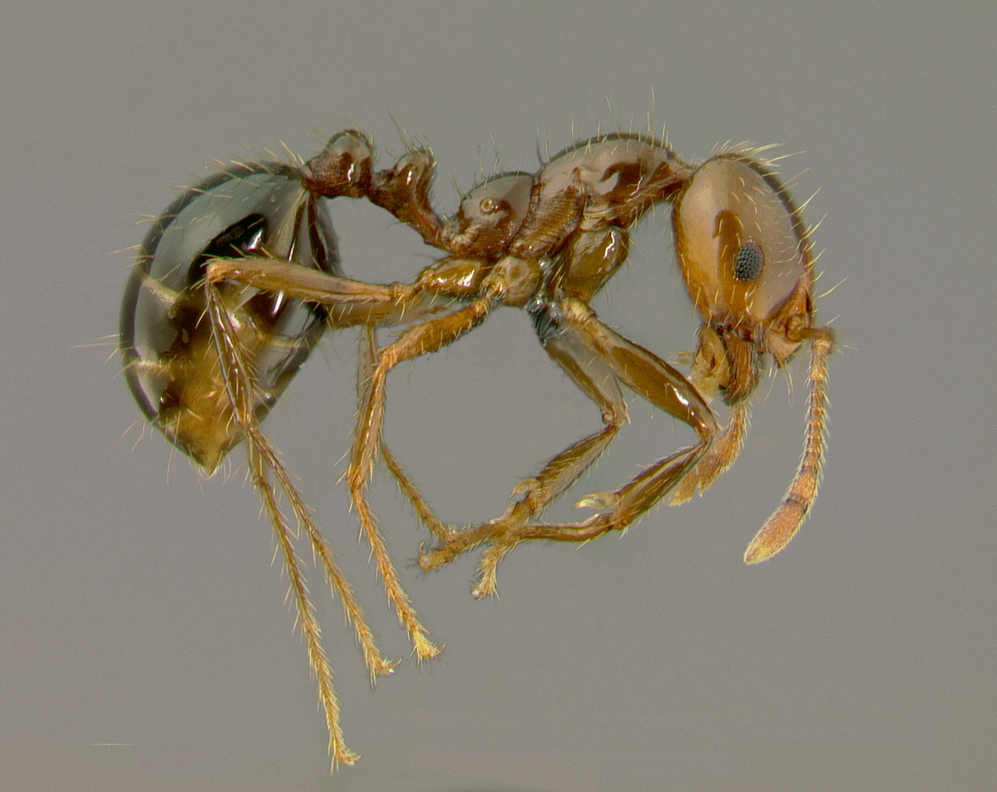
Notes:
69

Slide 70
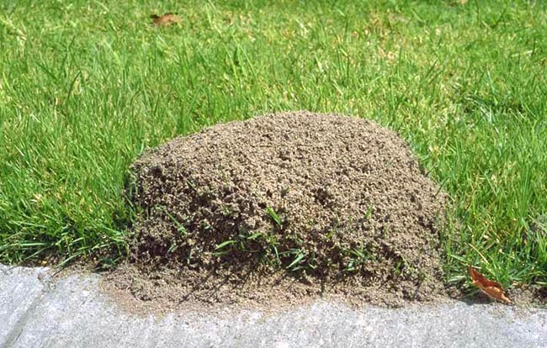

Slide 71
Those Who
Desire Suicide
Perceived
Burdensomeness
Those Who Are Capable of Suicide
Thwarted
Belongingness
Serious Attempt or Death by Suicide
Notes:
71

Slide 72
Constituents of the Desire for Death
Perceived Burdensomeness
Thwarted Belongingness
Notes:
72

Slide 73
Thwarted Belongingness
The need to belong to valued groups or relationships is a powerful, fundamental, and extremely pervasive human motivation. When this need is thwarted, numerous negative effects on health, adjustment, and well-being have been documented.
Notes:
73

Slide 74
Thwarted Belongingness
The view taken here is that this need is so powerful that, when satisfied, it can prevent suicide even when perceived burdensomeness and the acquired ability to enact lethal self-injury are in place. By the same token, when the need is thwarted, risk for suicide is increased. The argument is that the thwarting of this fundamental need is powerful enough to contribute to the desire for death. This perspective is similar to the classic work of Durkheim (1897), who proposed that suicide results, in part, from failure of social integration.
Notes:
74

Slide 75
Thwarted Belongingness: Empirical Evidence
Social isolation is a very strong risk factor.
  Stirman and Pennebaker’s (2001) study of language use by poets who died by suicide vs. non-suicidal poets suggested escalating interpersonal disconnection as the suicidal poets’ deaths neared. As the suicidal poets’ deaths approached, their use of interpersonal pronouns (e.g., “we”) decreased noticeably.
  Stirman, S.W., & Pennebaker, J.W. (2001). Word use in the poetry of suicidal and nonsuicidal poets. Psychosomatic Medicine, 63, 517-522.

Slide 76

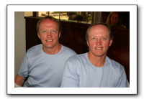
Thwarted Belongingness: Empirical Evidence
Twins die by suicide at lower rates than others despite having slightly higher rates of mental disorders.
  Tomassini et al. (2003). Risk of suicide in twins: 51 year follow up. British Medical Journal, 327, 373-374 .
Notes:
76

Slide 77
Belongingness Increases Fear of Death
Those who report having many supportive relatives are likelier to fear death.
  Harper’s Index, June 2010.
Having a sister helps
Notes:
77

Slide 78
Thwarted Belongingness: Empirical Evidence
Several studies have documented this association.
Joiner, T., Van Orden, K., & Hollar, D. (2006). On Buckeyes, Gators, the Miracle on Ice, and Super Bowl Sunday: Pulling Together Is Associated With Lower Suicide Rates. Journal of Social & Clinical Psychology.
Fernquist, R.M. (2000). An aggregate analysis of professional sports, suicide, and homicide rates: 30 U.S. metropolitan areas, 1971-1990. Aggression & Violent Behavior, 5, 329-341.
Steels, M.D. (1994). Deliberate self poisoning - Nottingham Forest Football Club and F. A. Cup defeat. Irish Journal of Psychological Medicine, 11, 76-78.
Trovato, F. (1998). The Stanley Cup of Hockey and suicide in Quebec, 1951-1992. Social Forces, 77, 105-126.
Notes:
78

Slide 79

Miracle on Ice, February 22, 1980
Notes:
79

Slide 80
Notes:
80

Slide 81
Notes:
81

Slide 82
Those Who
Desire Suicide
Distal
Factors
Perceived
Burdensomeness
Those Who Are Capable of Suicide
Thwarted
Belongingness
Serious Attempt or Death by Suicide
Notes:
82

Slide 83
Suicide’s Shoeing Horn
Black bile is suicide’s “shoeing horn” (Burton, 1621).
There does appear to be a shoeing horn, and it’s serotonergic dysregulation.

Slide 84
Interpersonal Theory & Veterans
Acquired Capability is necessary for actual behavior & behavior/AC high in veterans
  Some estimate 20% of all US suicides are veterans, yet they comprise 7.6% of population
  As of 2010, 800+ lives lost to suicide, 700+ lost in OEF Afghanistan conflict total
Thwarted Belongingness may actually increase risk when veteran not in group
Perceived Burdensomeness may be relevant to function & self-efficacy relative to group
Many distal factors may also be relevant

Slide 85
"The one transcendent factor that we seem to have, if there's any one that's associated with [suicide], is fractured relationships of some sort,"
Lieut. General Eric Schoomaker, the Army surgeon general

Slide 86
For veterans who are substance dependent
May increase perturbation if in withdrawal, lead to sleep problems & agitation
Could increase burdensomeness, capability, and decrease belonging
May occur in the context of mood disorder
  Suicidal thinking a DSM symptom for MDD
  Bipolar Disorder – highest risk (esp. BD II)
Rates may be high for particular addictions, such as heroin
  Some studies find 1/3 die within years

Slide 87
Suicide & Addiction
Perhaps most relevant as one of many factors
No clear evidence that most substance abuse deaths are necessarily suicide
  Intent
  Mind of the Deceased can’t be Accessed
Slow suicide through addiction often does not make sense
Many other factors may be more important
  Hopelessness
  Other Axis I Disorders
  Aspects of the IPT
  Agitation & sleep disturbance (esp. inpatient)
  Psychache

Slide 88
SAMSHA – National Survey on Drug Use and Health
Suicidal thinking and behavior actually more common in women
11% with SUD had suicidal thinking, compared to 3%
4X as likely to make suicide plans
6X as likely to attempt (total of 2% of sample with SUD)

Slide 89
Clinical Recommendations for Dealing with Suicide
Collect Specific Parameters of Ideation & Behavior, as well as Preparation/Rehearsal
Determine if Suicidal Ideation/Risk is Primary Clinical Need
Provide Client with Multiple Resources to Use in Crisis
Discuss suicide frankly with client, in a neither dismissive nor alarmist manner
Attend Training such as Assessing & Managing Suicide Risk or ASIST

Slide 90
Toward a Risk Assessment Framework
Two Most Important Areas: History of Previous Attempt/Fearlessness and Nature of Current Suicidal Symptoms
Regarding History of Previous Attempts, our research shows that people who have a history of 0 or 1 previous attempt are just in a different risk category than people who have 2 or more attempts. Regardless of all the other things going on, this one variable tells you a lot about risk. The multiple attempters are virtually always in a higher risk category than their counterparts with 0 or even 1 previous attempt.

Slide 91
Toward a Risk Assessment Framework
Two Most Important Areas: History of Previous Attempt/Fearlessness and Nature of Current Suicidal Symptoms

Slide 92
Resolved Plans & Preparations
This symptom cluster includes
  Vivid, detailed, long-lasting ideas about suicide
  A sense of competence about suicide
  A sense of fearlessness about suicide.
  Well-developed plans
  Dangerous set of symptoms
Notes:
Recall early case examples where both patients professed a desire for death, but the one was courageous about it, increasingly so, whereas the other became afraid and phoned someone.

Slide 93
More on Risk Categories
The coping card simply involves the development of a straightforward crisis plan that can be written down on the back of a business card, a 3 x 5 index card, or a sheet of paper. An example would be “When I’m upset and thinking of suicide, I’ll take the following steps:

Slide 94
More on Risk Categories
The coping card (cont).: 1) use what I’ve learned in therapy to try to identify what is upsetting me; 2) write down and review some reasonable, non-suicidal responses to what is bothering me; 3) try to do things that, in the past, have made me feel better (e.g., talking to , music, exercise, etc.); 4) if the suicidal thoughts continue and get specific, or I find myself preparing for suicide, I’ll call the emergency call person at (phone number; xxx-xxxx) or 1-800-273-TALK; 5) if I feel that I cannot control my suicidal behavior, I’ll go to the emergency room or call 911.”

Slide 95
More on Risk Categories
If risk category is Severe: actions are similar to those for Mild-Moderate, but “stepped” up (e.g., do most or all of these), and voluntary hospitalization is discussed. Again, documentation in progress notes of risk category and attendant actions is necessary.
If risk category is Extreme: Hospitalization is enacted.
Documentation: Just do it every time.

