Slide 1
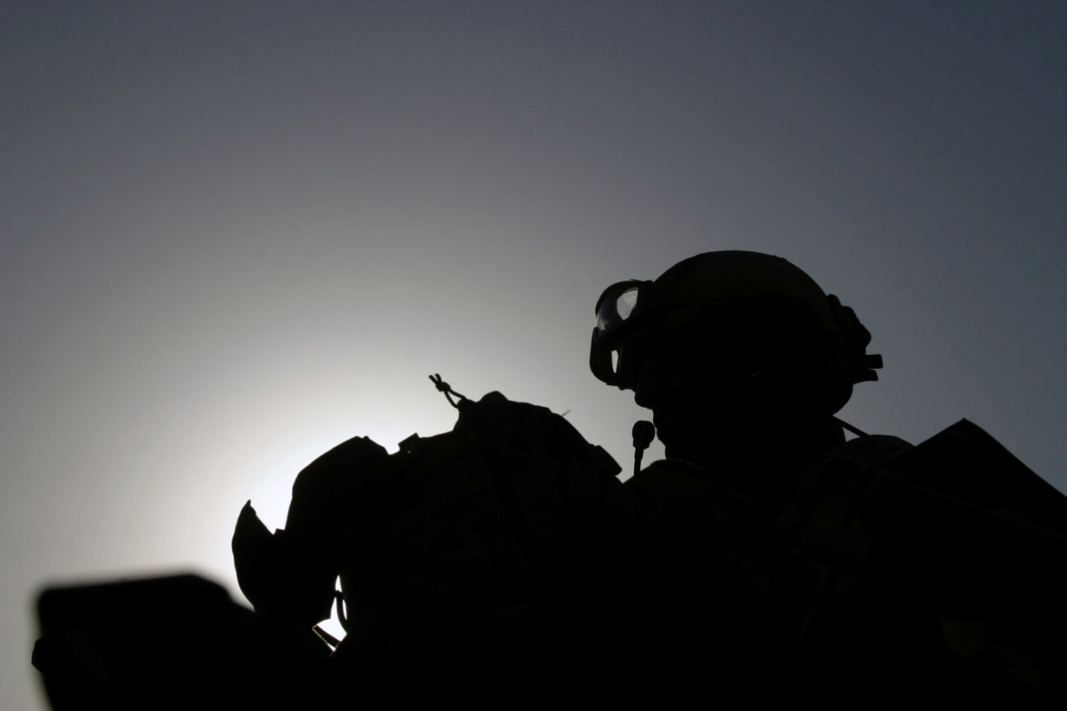
Chronic Pain Issues: Physical and Psychological Aspects
Michael E. Clark, Ph.D.
Pain Programs Section Leader, Tampa VA
Co-Chair, VA National Pain Management Workgroup
Associate Professor, Department of Psychology, University of South Florida

Slide 2
Disclosures
No disclosures
This presentation in part is based on data obtained via an HSR&D-funded research project (SDR-07-047).
Any opinions or conclusions presented are those of the author and do not necessarily reflect those of the Department of Veterans Affairs.

Slide 3
Objectives
Describe the constellation of symptoms and the prevalence that characterize Post-deployment Multi-symptom Disorder (PMD).
Recognize the 5 most common diagnoses that occur in PMD.
Identify alternative integrated care treatment strategies for pain and pain-related comorbidities (PMD).

Slide 4
OEF/OIF Primary Patient Populations
POLYTRAUMA
Active duty or VA outpatients
Present with severe injuries, typically blast-related
Active duty and discharged personnel
Moderate to severe TBIs common
OEF/OIF
Active duty or VA outpatients
Present with less severe injuries or general health issues
Mild TBIs common

Slide 5
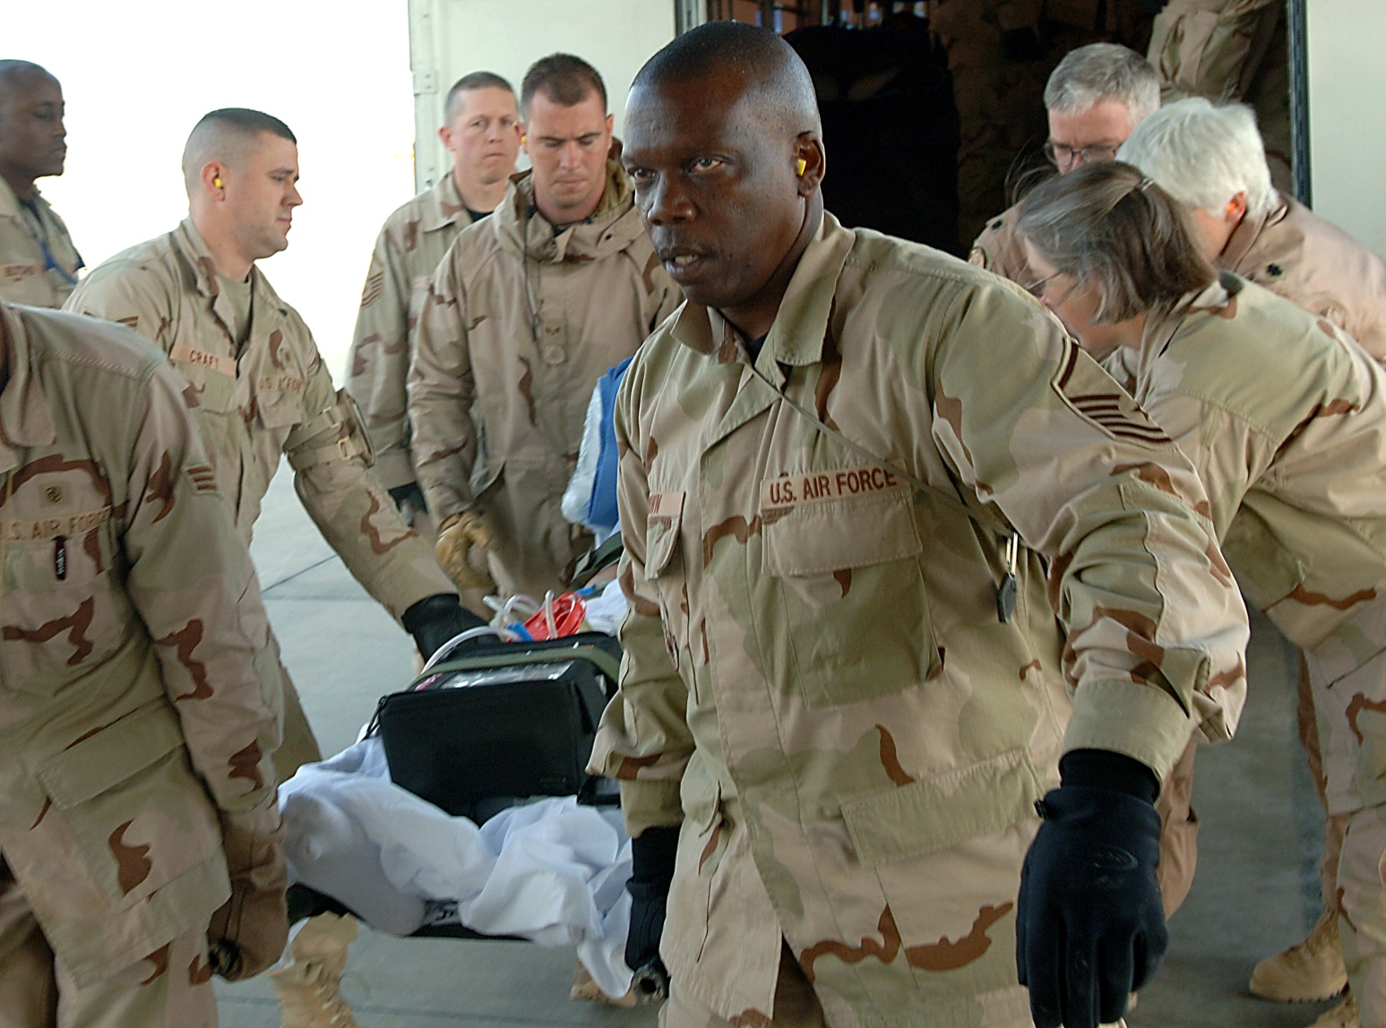
Physical Injuries
Photo by Airman 1st Class Nathan Doza, USAF

Slide 6
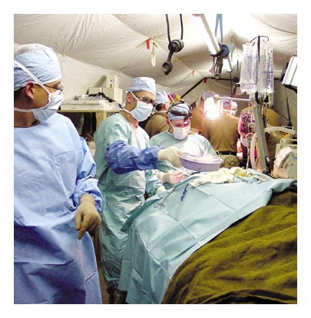

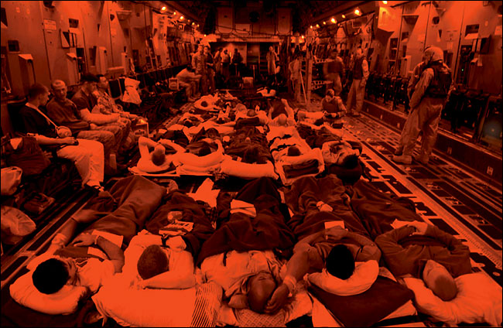
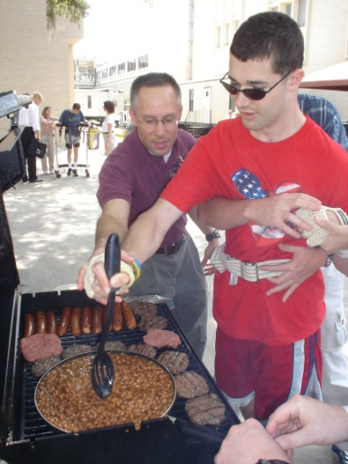


Continuum of Care: Serious Injuries
Combat Support Hospital and forward Surgical teams
Level IV Hospital (Landstuhl)
Military Air Evacuation
Local VA or
Community Care
Military Treatment Facility
(WRAMC; Bethesda)
VA Polytrauma
Rehabilitation Center
Lynsey Addario/Corbis
NY Times

Slide 7

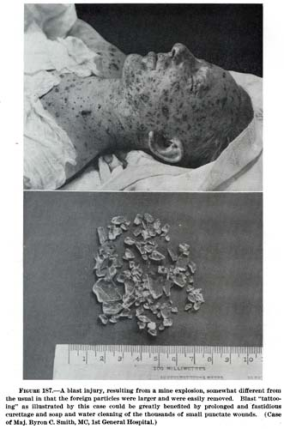
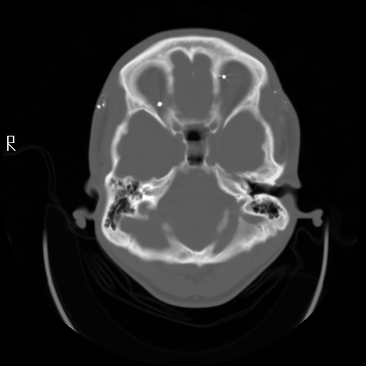
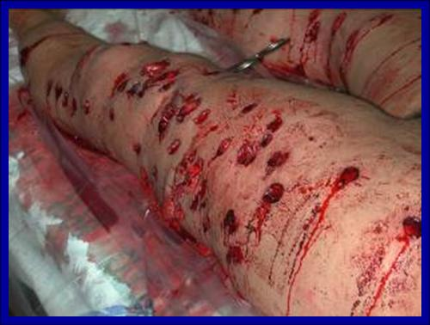
The Injuries
Fragmentation Injuries

Slide 8
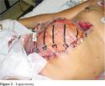
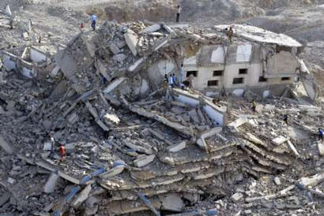
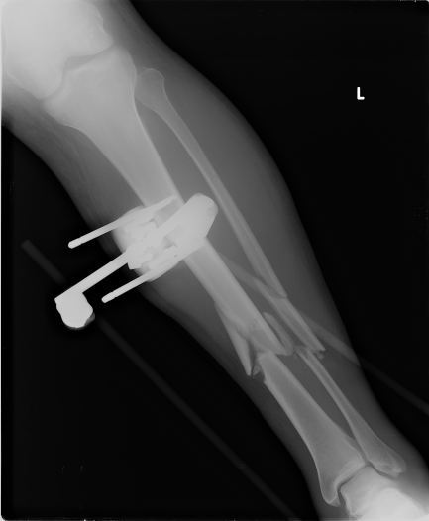
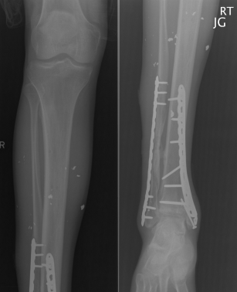
The Injuries
Blunt Trauma and Crush Injuries

Slide 9
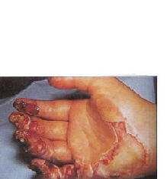
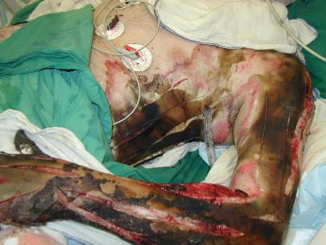
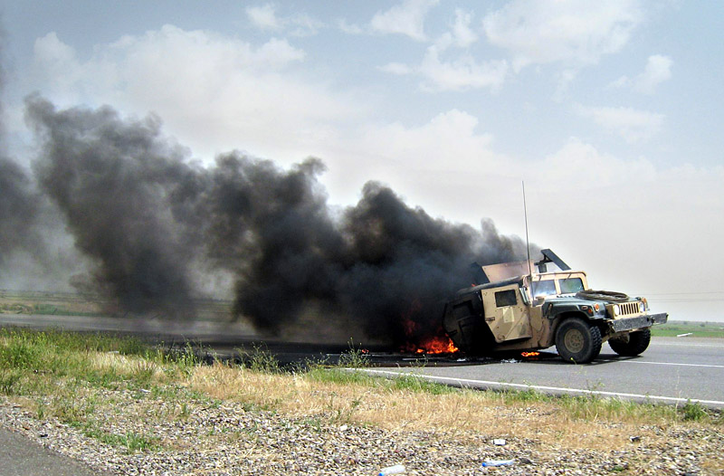
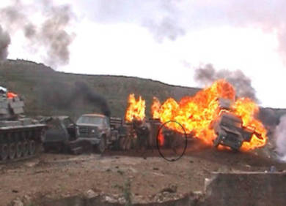
The Injuries
Burns

Slide 10
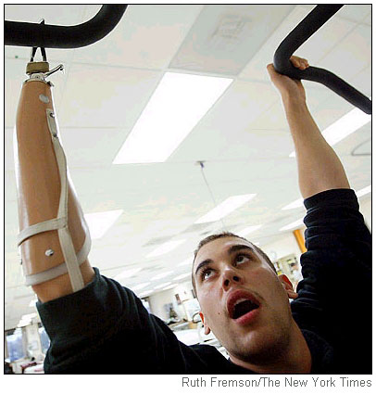
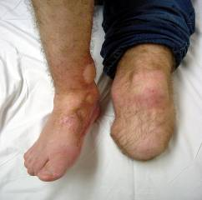
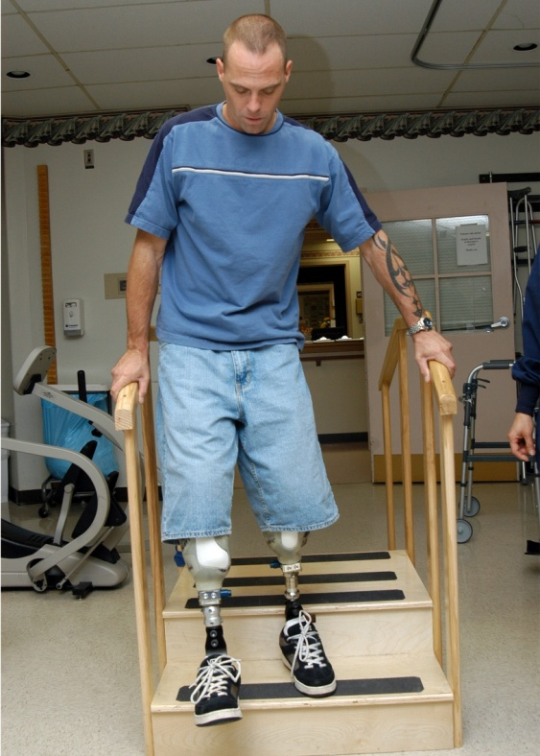
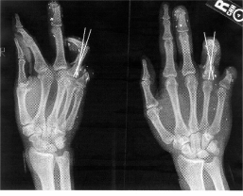
The Injuries
Traumatic Amputations

Slide 11
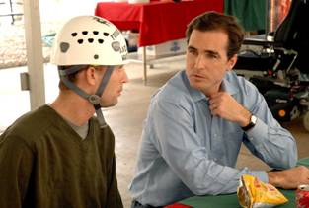
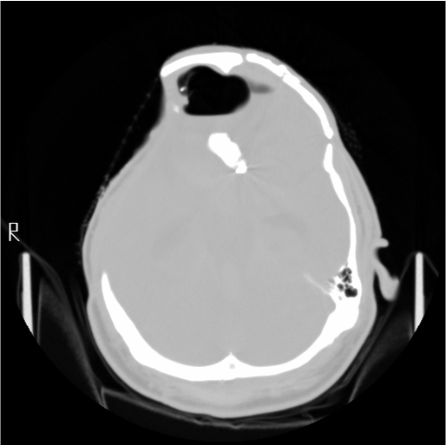
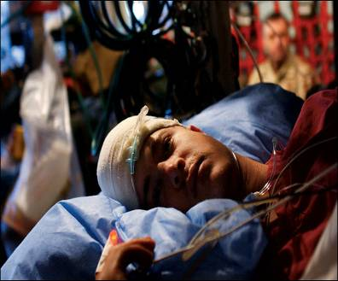
The Injuries
Brain Injury
May be closed or penetrating
Range from mild to severe
Cognitive deficits may complicate pain and other Tx

Slide 12
Polytrauma
Originally defined as “an injury to the brain and at least one other body part or system”
Changed to “two or more injuries to physical regions or organ systems”
  TBI common but no longer required
  Emotional functioning accepted as a separate organ system
  So any physical injury accompanied by emotional problems (e.g., PTSD) = Polytrauma

Slide 13
Polytrauma Injuries- Evacuees
(Clark, Bair, Buckenmaier, Gironda, & Walker, 2007)
Table 2. Characteristics of Combat Casualties Treated with Regional Anesthetic Blocks (N=287)
Male
Female
Characteristic
(n=269)
(n=18)
Mean Age
in Years
(
sd
)
28.1
(
.5
)
27.5
(
1.7
)
Injury Mechanism
Blast or Fragment
164 (61.0%)
6 (33.3%)
Bullet
38 (14.1%)
1 (5.6%)
MVA
11 (4.1%)
3 (16.7%)
Other
12 (4.4%)
2 (11.1%)
Unknown
44 (16.4%)
6 (33.3%)
Injury Distribution
Orthopedic
189 (70.3%)
15 (83.3%)
Polytrauma
72 (26.8%)
2 (11.1%)
Other single site
8 (2.9%)
1 (5.6%)
Based on 287 Walter Reed Army Medical Center evacuees treated with Regional Analgesia

Slide 14

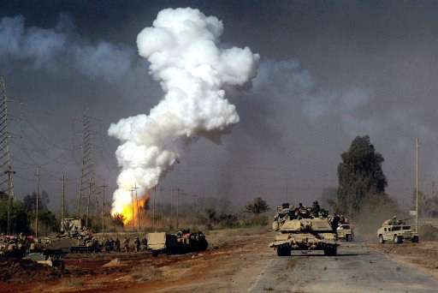
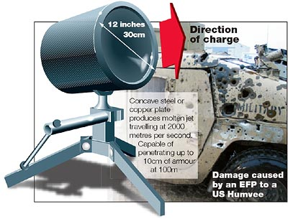
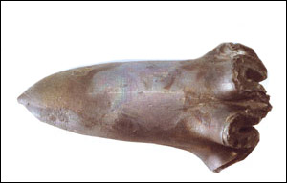
Blast Injuries
Most common cause are IEDs and EFPs (explosively formed penetrator)

Slide 15
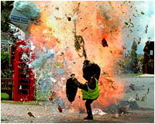
Blast Mechanisms of Injury
  Primary – Effects of Overpressure and Underpressure
  Secondary – Flying Debris/fragments
  Tertiary – Body Displacement
  Quaternary – Burns

Slide 16
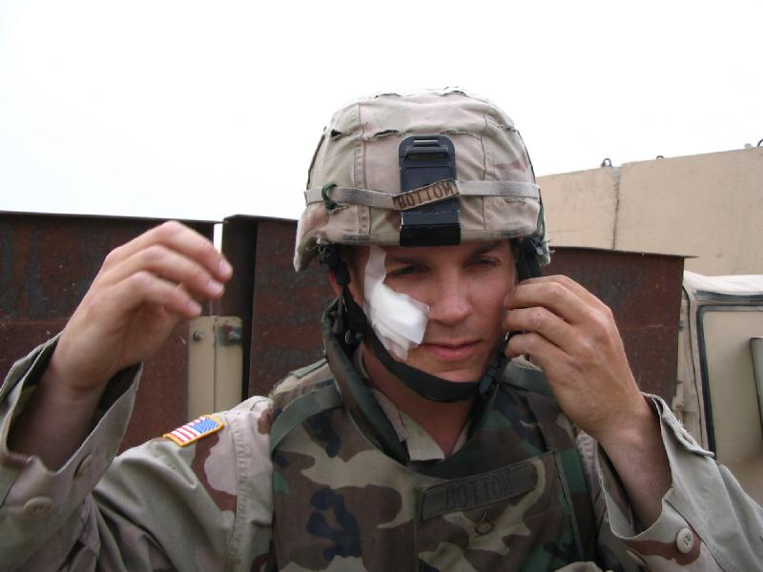
Primary Blast Injuries
Transverses the body. It may initiate metabolic and neuroendocrine changes
Biochemical disturbances affect recovery of direct injuries from blasts
Body impairments may be underestimated.

Slide 17
Barotrauma
Overpressure (psi) | Blast Loading
<20 | Minor – Rupture of eardrums
10-50 | Moderate – Primary lung damage
50-80 | Severe – Lung damage
>80 | Very Severe – Significant risk of death

Slide 18
Blast Exposure and Pain Issues
Pain Medicine, April 2009 Issue
Comparison of Pain and Emotional Symptoms in Soldiers with Polytrauma: Unique Aspects of Blast Exposure
Michael E. Clark, PhD,*,† Robyn L. Walker, PhD,* Ronald J. Gironda, PhD,*,† and
Joel D. Scholten, MD†,‡
*Chronic Pain Rehabilitation Program, James A. Haley Veterans Affairs Hospital, †University of South Florida
‡Polytrauma Rehabilitation Center, James A. Haley Veterans Affairs Hospital, Tampa, Florida, USA

Slide 19
Measure | Non-Combat (n=43) | Combat/Blast (n=51) | Combat/Non-Blast (n=34)
# Injuries* | 2.6 (1.0) | 3.4 (1.2) | 2.9 (1.3)
# Pain Sites | 2.2 (1.5) | 2.4 (1.3) | 2.0 (1.5)
Pain Intensity | 4.5 (3.0) | 5.4 (2.3) | 4.4 (2.8)
Closed TBI* | 82.9% | 29.6% | 64.6%
Open TBI* | 7.1% | 53.5% | 14.6%
Amputation* | 2.3% | 16.0% | 2.9%
Otological Injury* | 11.6% | 35.3% | 32.4%
PTSD Dx* | 2.3% | 45.1% | 11.8%
Any MH Dx* | 52% | 86% | 53%
FIM Score | 89.5 (32.8) | 81.0 (31.8) | 80.1 (30.4)
Rancho Level | 5.9 (1.4) | 6.3 (1.4) | 6.0 (1.0)
BOLDED entries indicate significant differences between groups
* p < .05
CLARK- 2011

Slide 20
Complexity of Polytrauma Pain
Otalgia
Headache
Polytrauma
Pain
Hearing Loss & Tinnitus
TBI
Surgical revisions
Acute Pain
Neuropathic
Pain
Nerve
Injury
SCI
Orthopedic & Soft Tissue Trauma
Amputations
Central
Pain
Phantom
Pain
Nociceptive
Pain
Adapted with permission from Scott, 2008

Slide 21
Polytrauma Pain Course

Slide 22
Polytrauma Pain Characteristics
Pain prevalence = 96%
Clark, Bair, Buckenmaier III, Gironda, & Walker, 2007
Headaches and cervical pain from traumatic brain injuries and blast injuries (65%)
Extremity pain from blast injuries (55%)
Neuropathic pain from fasciotomies (30%)
Phantom limb pain from amputations (20%)
Back pain (20%)
Burn pain from blast injuries (10%)
Diffuse pain from numerous soft tissue shrapnel wounds (10%)
Clark, Scholten, Walker, & Gironda, 2009

Slide 23
Course of Pain: Predeployment Back Pain
Notes:
What does the Y axis represent? Pain intensity scale? Prevalence? Pain- standard NRS. Will be clear in presentation.

Slide 24
Course of Pain: Soft Tissue Injury
Notes:
Y axis? Pain- standard NRS. Will be clear in presentation.

Slide 25
Course of Pain- Blast-related Headache
Course of Pain- Blast-related Headache
Notes:
Y axis? Has these data been published or your experience only? Pain- standard NRS. Will be clear in presentation. These are examples. Specific pain intensity is irrelevant- that’s not the point.

Slide 26
Course of Pain- Burns
Course of Pain- Burns
CLARK -2011
Notes:
Same questions as before

Slide 27
Course of Pain- Surgical Revisions
Course of Pain- Surgical Revisions
Notes:
Same questions as before

Slide 28
Combined Course of Polytrauma Pain
Combined Course of Polytrauma Pain
Notes:
Same questions as before

Slide 29
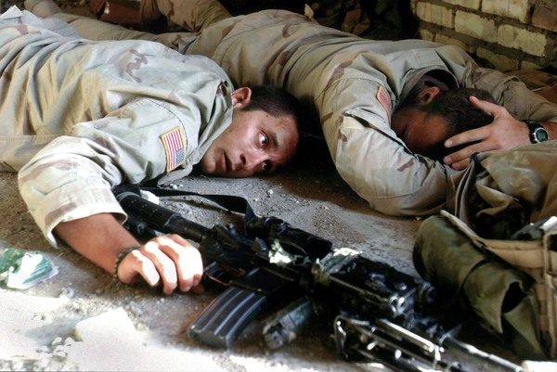
Emotional Injuries
Photo by Jim MacMillan, Associated Press, © 2004
CLARK- 2011

Slide 30
Foundations of Post-deployment Multi-symptom Disorder (PMD)
2003-2006
Provided early data on the prevalence of pain among patients with polytrauma (75-88%) and OEF/OIF returnees (40-50%).
Pain clinicians at Tampa identified frequent overlap of pain, mTBI, PTSD, and other emotional symptoms
2007
Initiated first VA funded study examining pain and emotional comorbidities among veterans and service members
2008
Developed the “P3” description (pain, PTSD, and post-concussive disorder)
2009-2010
Developed and published the concept of PMD
CLARK- 2011

Slide 31
Symptom Overlap (P3)
Lew, Otis, Tun, Kerns, Clark, & Cifu, 2009
Sample = 340 OEF/OIF outpatients at Boston VA
TBI/Pain
12.6%
TBI
PAIN
10.3%
5.3%
Pain, TBI, & PTSD
Pain/PTSD
6.8%
TBI/PTSD
16.5%
42.1%
Overall prevalence:
Pain 81.5%
TBI 68.2%
PTSD 66.8%
PTSD
2.9%

Slide 32
PMD Definition
PMD refers to a constellation of overlapping physical and emotional symptoms common among OEF/OIF service members that negatively impact Quality of Life, daily function, and transition to life as a civilian.
Gironda, Clark, Ruff, Chait, Craine, Walker, & Scholten, 2009
Walker, Clark, & Sanders, 2010
CLARK- 2011

Slide 33
PMD Symptoms
Sleep Disturbance
Low Frustration Tolerance/Irritability
Concentration/Attention/Memory Problems
Fatigue
Headaches
Musculoskeletal Disorders (i.e. chronic pain)
Affective Disturbance
Apathy
Personality Change
Substance Misuse (including opioid misuse)
Activity Avoidance or Kinesiophobia
Employment or school difficulties
Relationship conflict
Hypervigilance

Slide 34
Latest Data
Research Data
Longitudinal (12-month) VA-funded two-site study
353 participants recruited either from local OEF/OIF registries or the polytrauma network of care
First study to use validated structured clinical interview (M.I.N.I.) to establish DSM-IV diagnoses along with multiple symptom and function measures
Clinical Data
Local IRB-approved retrospective study
Implemented PMD screenings for all OEF/OIF/OND veterans registering for care at Tampa VA
Screenings utilize validated symptom measures and a clinical interview

Slide 35
Demographics
Age (years) | 35.1 | Education (years) | 14.5
Sex |  | Duty Status at Baseline
Male | 91.1% | Active Duty | 11.7%
Female | 8.9% | Inactive Reserve | 10.6%
Race |  | Active Reserve | 20.9%
Caucasian | 77.4% | TDRL | 1.7%
Hispanic | 10.0% | Completed obligations | 55.2%
Black | 9.5% | Service Branch¹
Other | 3.1% | Army | 48.7%
Marital |  | Navy | 8.1%
Never Married | 24.2% | Air Force | 8.4%
Married | 52.4% | Marines | 10.9%
Divorced/Sep | 16.4% | National Guard | 24.2%
Living with someone | 6.7% | Deployed from
Other | 0.3% | Active duty | 54.5%
Employment Status |  | Inactive reserve | 30.1%
Full-time | 54.3% | Active reserve | 15.4%
Part-time | 7.5% | Deployed to
Unemployed/looking | 11.1% | OEF only | 10.6%
Unemployed/not looking | 0.8% | OIF only | 69.6%
Disabled | 5.8% | Both OEF/OIF | 18.1%
Student | 15.9% | Total deployment months | 14.6
Retired | 1.7% | Mean months since return | 42.4
Other | 2.9%
¹Some participants had multiple deployments in different service branches

Slide 36
Injuries and Pain
Injury Onset* |  | Injury Type**
No Injuries Reported | 13.9% | Orthopedic | 52.3%
Pre-service | 1.4% | Soft Tissue | 41.6%
Pre-deployment | 12.6% | Closed Head Injury | 33.9%
Combat | 37.3% | Penetrating Wound | 9.4%
Non-combat | 38.2% | Ear | 6.6%
Post-deployment | 3.6% | Other | 5.9%
Post-service | 0.6% | Burns | 3.3%
Injury Method** |  | Open Head Injury | 1.6%
Blast | 31.3% | Amputation | 1.3%
Fall | 16.1% | Eye | 1.3%
Vehicular | 14.0% | Spinal Cord Injury | 0.3%
Shrapnel | 4.5% | Years since injury | 4.8
GSW | 1.0% | # Blast Exposures | 73.9
Other | 46.8% | Distance from closest blast (feet) | 324.7
Primary Pain Location***
Back | 33.5% | Lower extremities | 18.9%
Head/Neck | 25.0% | Torso | 2.1%
Upper extremities | 15.8% | Other | 4.7%
*Some reported more than 1 injury
**Percent of those reporting injuries
***Percent of those reporting pain

Slide 37
Mental Health Issues
Current or prior MH problem | 66.9% | Reported impairments
Onset of MH problem* |  | Activity | 72.0%
Pre-service | 5.9% | Sleep | 65.8%
Pre-deployment | 7.1% | Recreational | 62.2%
Combat non-blast related | 2.9% | Occupational | 54.3%
Combat blast-related | 13.8% | Emotional | 59.9%
Non-combat/during deployment | 13.8% | Social | 47.3%
Post-deployment | 50.6% | Familial | 42.0%
Post-service | 5.9% | Sexual | 35.4%
Resolution of MH problem
Before deployment | 1.3% | After deployment | 8.8%
During deployment | 2.1% | Ongoing- not resolved | 87.9%
*Percent of those reporting mental health problems

Slide 38
DSM-IV Diagnoses
Anxiety |  | SUDs
Panic disorder | 18.1% | ETOH dependence | 13.9%
Agoraphobia | 28.7% | ETOH Abuse | 9.7%
Social Phobia | 9.5% | Opioid Dependence | 1.4%
Obsessive-compulsive disorder | 12.5% | Opioid Abuse | 0.6%
Generalized Anxiety Disorder | 16.7% | Other Substance Dependence | 3.1%
PTSD | 26.5% | Other Substance Abuse | 2.8%
1 or more anxiety disorders | 49.9% | Polysubstance Abuse | 0.6%
Depression |  | 1 or more SUD | 26.2%
Major Depression | 29.5% | Postconcussional Disorder | 16.2%
Dysthymia | 6.6% | Mood Disorder with Psychotic Features | 5.0%
Hypomania | 23.1%
1 or more depressive disorders | 45.4% | At least 1 M.I.N.I. Axis I Diagnosis* | 67.1%
Pain
Any Pain Present | 86.6%
Significant Pain Present | 55.9%

Slide 39
Prevalence of Axis I Diagnoses

Slide 40
Multiple Diagnoses

Slide 41
Frequency of Sleep Problems by Dx

Slide 42
Most Frequent Comorbid Diagnoses

Slide 43
Summary
Almost 2/3rds of participants met criteria for at least 1 emotional disorder
The majority of participants had more than 1 problem that met diagnostic criteria (i.e., PMD).
Most common diagnoses among OEF/OIF personnel receiving or registered for VA care at these two VA sites were pain, mood disorders, anxiety disorders (other than PTSD), PTSD, Substance Use Disorders, mTBI, and psychotic disorders, in that order.
Sleep problems were associated with all diagnoses.
mTBI (1.9%) and PTSD (0.3%) almost never occurred in the absence of the other comorbidities we assessed.

Slide 44
PMD in Post Deployment Clinic
ALL OEF/OIF/OND deployees registering for care at Tampa VA are screened for PMD
Screening includes an interview with a MH provider and several screening instruments that are used to identify potential problem areas
Those who verbally report MH or PMD problems or those who score above certain cutoff values on the screening instruments are evaluated more fully and referred for indicated services

Slide 45
Results (n=356)
Measure | Domain | Range | Threshold* | M | (SD) | % > cutoff
GAD-7 | Anxiety | 0-21 | > 10 | 7.4 | 6.6 | 34.8%
PHQ-9 | Depression | 0-27 | > 10 | 7.8 | 7.0 | 37.1%
PCL | PTSD | 17-85 | > 50 | 37.6 | 19.5 | 28.7%
SPQ | Sleep Complaints | 0-20 | > 12 | 9.8 | 7.1 | 46.9%
PHQ-15 | Health Complaints | 0-30 | > 10 | 8.5 | 5.8 | 39.6%
SA-5 | Alcohol Subtest only | # Drinks/week | Male > 15 | 9.1 | 14.0 | 18.0%
 | Composite score = days/wk x drinks/sitting |  | Female> 8 | 4.6 | 6.6 | 15.4%
NRS | Pain Avg in past wk | 0-10 | > 4 | 3.6 | 2.8 | 46.3%
*Cutoffs reflect MODERATE or higher scores
Agliata, Takagishi, Clark, & Gironda, 2011

Slide 46
Number of Problem Areas

Slide 47
Implications
Deployment-related physical and emotional problems overlap and coexist. PTSD and mTBI almost never occur without other comorbidities.
There is substantial evidence in the literature that these comorbidities can interact (strongest for pain, mTBI, and PTSD).
The complexity and challenges represented by PMD may require alternative treatment methods such as INTEGRATED CARE.

Slide 48
Traditional VA Specialty Care
OEF/OIF/OND Patients
Meet criteria
Do not meet criteria
PTSD Tx Program
TBI Tx Program
Pain Tx Program
Primary Care Tx

Slide 49
Alternative Model of Specialty Care
OEF/OIF Patients
Multiple Symptoms Discrete Disorders
Integrated OEF/OIF/OND Care for PMD
Specialty
Programs (PTSD; mTBI; Pain)
Primary Care Tx

Slide 50
Advantages of Integrated Care
Provides comprehensive, multi-symptom care within a single program at a single location by a group of providers who share a common philosophy of treatment.
Integrated evaluations may provide a more complete picture of an individual’s functioning than specialty focused evaluations.
Facilitates a continuum of care rather than episodic care.
Addresses the specific problem symptoms as well as their interactions.

Slide 51
PMD Integrated Care at Tampa VA
Post Deployment Clinics
Polytrauma Teams
DoD Facilities
Evaluation/Tx Planning
Focused Treatments (existing & expand)
Required Core Treatment:
Life Needs : Group (Intro; Sleep
Hygiene, Relaxation Skills; SUD ) ;
Individual; Med management; PT
TBI Tx
Pain Tx
CPHE
Existing Programs
Optional Core Treatments:
Anger Management
Fear/Avoidance
Cognitive Adaptation
Headache Management
Pain Rehabilitation
Relationship Enhancement
PTSD Tx
Substance
Abuse Tx
Voc Rehab

Slide 52
Integrated Care Case Example: Staff Sergeant H.
Hx: 29 year old, married, Caucasian female on active duty with the Army. She has 2 years of college education and enlisted in 2000. Injured by an IED blast in Iraq while riding in the front of a vehicle. LOC of unknown duration. No mental health Hx; prior medical Hx unremarkable.
Injuries/Problems:
  Severe trauma to the RLE which required a right-sided AKA.
  3% total body surface area burns to the LLE
  TBI (increased signal in bilateral basal ganglia consistent with hypoxic/ischemic injury) with PCHA (migraine-like)
  RLE HO interfering with prosthesis and with associated stump pain
  RLE residual phantom pain
  Multiple shrapnel injuries with localized pain
  Cognitive impairment
  PTSD
  Depression

Slide 53
Staff Sergeant H.
Medevac’d from Iraq, admitted to WRAMC
  Multiple stump revisions
  Multiple wound washouts
  Debridement
  Fit with prosthesis but could not use
Admitted to Tampa 3 months post-injury
  Alert, responsive, limited cognitive deficits though sedated
  Avg pain = 7-9
  Depressed & anxious
  Transfer pain meds = methadone, oxycodone, dilaudid, transmucosal fentanyl, duloxetine, and pregabalin, along with clonazepam and risperidone for UE and facial choreiform movements
  Primary pain RLE stump and phantom pain
  Secondary soft tissue pain from shrapnel wounds, HAs, and diffuse musculoskeletal pain
  Substantial impairments in mobility, endurance, and sleep

Slide 54
Evaluation & Treatment
Initially evaluated by extended polytrauma care team including Speech and Audiology
Pain-related Problems:
  Opioids reduced rehab involvement
    Plan: Educate and titrate oral agents; D/C transmucosal
  RLE residual pain and HO interfering with prosthesis and ambulation training
    Plan: HO workup and symptomatic Tx; Intensive PT & gait training; multiple (on-site) prosthetics revisions; TENs
  PTSD symptoms aggravating pain and sleep problems
    Plan: Individual CBT focused on interrelationships for above
  Musculoskeletal pain & loss of physical functioning
    Plan: CBT, PT, OT, KT, RT, graded exercises, self-management training
  Depression and anxiety related to PTSD, aggravated by pain
    Plan: Relaxation Tx; CBT; duloxetine; family education and therapy

Slide 55
Outcomes
Admission
Discharge
6 mo. FU
(LOS = 30 days)
Morphine equiv avg. daily dose | 240 mg | 30 mg | 0
Avg Pain Score | 7-9 | 0-2 | 0-2
Activity Level | Minimal | Normal | Above normal
Sleep | Very impaired | Minimally impaired | Normal
Depression | Moderate | Mild | Not depressed
PTSD | Moderate | Mild | Mild
Addendum: Staff Sergeant H. continued in active duty for several years helping other returning wounded soldiers cope with their conditions. One-year after treatment she competed in the Special Olympics. Currently she is retired and employed full time.

Slide 56
Selected References
Clark, M.E., Scholten, J.D., Walker, R.L., & Gironda, R.J. (2009). Assessment and treatment of pain associated with combat-related polytrauma. Pain Medicine, 10(3), 456-469.
Clark, M.E., Walker, R.L., Gironda, R.J., & Scholten, J.D. (2009). Comparison of Pain and Emotional Symptoms in Soldiers with Polytrauma: Unique Aspects of Blast Exposure. Pain Medicine, 10(3), 447-455.
Clark, M.E., Bair, M.J, Buckenmaier III, C.C., Gironda, R.J., and Walker, R.L. (2007). Pain and OIF/OEF combat injuries: Implications for research and practice. Journal of Rehabilitation Research & Development, 44, 179-194.
Dobscha, SK, Clark, M.E., Morasco, B.J., Freeman, M., Campbell, R., & Helfand, M. (2009). A Systematic Review of the Literature on Pain in Patients with Polytrauma. Pain Medicine, 10(7), 1200-17.
Gironda, R.J., Clark, M.E., Ruff, R., Chait, S., Craine, M., Walker, R.L., & Scholten, J. (2009). Traumatic Brain Injury, Polytrauma, and Pain: Challenges and Treatment Strategies for Polytrauma Rehabilitation. Rehabilitation Psychology, 54, 247-258.
Gironda, R.J., Clark, M.E., Massengale, J.P., & Walker, R.L. (2006). Pain among veterans of Operations Enduring Freedom and Iraqi Freedom. Pain Medicine, 7, 339-343.
Hoge, C.W., McGurk, D., Thomas, J.L., Cox, A.L., Engel, C.C., & Castro, C.A. (2008). Mild traumatic brain injury in U.S. Soldiers returning from Iraq. New England Journal of Medicine, 358(5), 453-63.
Lew, H.L., Otis, J.D., Tun, C., Kerns, R.D., Clark, M.E., & Cifu, D.X. (2009). Prevalence of Chronic Pain, Posttraumatic Stress Disorder and Post-concussive Symptoms in OEF/OIF Veterans: The Polytrauma Clinical Triad. Journal of Rehabilitation Research & Development, 46, 1-6.
Kalra, R., Clark, M.E., Scholten, J.D., Murphy, J.L., & Clements, K.L. (2008). Managing pain among returning service members. Federal Practitioner 25, 36-45.
Ruff, R. L., Ruff, S. S., & Wang, X. F. (2008). Headaches among Operation Iraqi Freedom/Operation Enduring Freedom veterans with mild traumatic brain injury associated with exposures to explosions. Journal of Rehabilitation Research and Development, 45, 941-952.
Sayer, N. A., Chiros, C. E., Sigford, B., Scott, S., Clothier, B., Pickett, T. et al. (2008). Characteristics and rehabilitation outcomes among patients with blast and other injuries sustained during the Global War on Terror. Archives of Physical Medicine and Rehabilitation, 89, 163-170.
Shipherd, J.C., Keyes, M., Jovanovic, T., Ready, D.J., Baltzell, D., Worley, V., Gordon-Brown, V., Hayslett, C., & Duncan, E. (2007). Veterans seeking treatment for posttraumatic stress disorder: What about comorbid chronic pain? Journal of Rehabilitation Research and Development, 44, 153-166.
Walker, R.L, Clark, M.E. & Sanders, S.H. (in press). The “Post-Deployment Multi-Symptom Disorder”: An emerging syndrome in need of a new treatment paradigm. Psychological Services.
Walker, R.L., Clark, M.E., Nampiaparampil, D.E., Mcllvried, L., Gold, M.S., Okonkwo, R., & Kerns, R.D. (2010). The hazards of war: Blast injury headache. The Journal of Pain, 11, pp. 297-302.

