Slide 1



Center For
Deployment Psychology
© Henry M Jackson Foundation All Rights Reserved

Slide 2
Service Members and Veterans on Campus
MFRI – Battlemind to Home II Symposium
November 16, 2011
Ted C. Bonar, Psy.D.
Center for Deployment Psychology
Uniformed Services University of the Health Sciences
Notes:
Prep work:
# of undergrads:
# of vets (estimate 3 – 4%):

Slide 3
Disclaimer
This project is sponsored by the Uniformed Services
University of the Health Sciences (USU); however, the information
or content and conclusions do not necessarily represent the official
position or policy of, nor should any official endorsement be
inferred on the part of, USU, the Department of Defense, or the
U.S. Government.
Notes:
Disclaimer for Counseling Centers:
-- DoD does not vet the program and might not agree with what we present
** This can be important at Counseling Centers…staff clinicians and university personnel do not necessarily know who we are and often wonder about our motivation/mission. Sometimes they feel we are there to promote or defend the military. They appreciate hearing about our mission to provide training as well as our connection with APA accredited internships.

Slide 4
Why join?
Family tradition
Transition to manhood/womanhood
To serve country
Support family
Friend did it
Get out of trouble with the law
Do something noble with life
Give life (death) a purpose
Protect people, country and way of life
Be a part of team - something bigger than self
Inherent sense of selflessness
College money, Free medical care, Travel
Get out of poverty
Notes:
UC4:
Brief discussion of why people enter the military.
Ask:
Are any of these inherently “wrong” or “bad”?
What are others?
Question:
What if someone’s military experience does not match their expectations/reasons for joining?
Talking point:
For clinicians, the question “Why did you join the military” is highly informative about a person’s background, values, resources, character, wishes for the future, identity, etc. The question also prompts informative follow-up discussion during clinical interview (expectations, current status as a vet or NG, success or failure, career preferences, state of integration/reintegration on campus/civilian community).

Slide 5

Service Members on Campus
Notes:
UC4:
- Hide this slide when printing. Make visible for the presentation. –
Can you identify the vet in this picture?
SGT Stephenie Austin (middle) is pictured with other friends who are also in the Illinois NG. This is a pic of them at a football tailgate party. If you saw these young women on campus, would your first thought be “they are veterans”?
We will discuss Stephenie throughout the day. She joined the Illinois National Guard at 17, attended Basic during the summer before her senior year of high school, and attended NG drill once per month during high school. Upon arriving at college for her freshman year in August of 2005, she was mobilized with her unit to New Orleans to clean up after hurricane Katrina. She returned to school during her first semester, and maintained her status as a Guard member and full-time student for the next three years. She deployed to Afghanistan for one year after her junior year of college, and returned to U of I to complete her degree after missing three semesters due to deployment.
NOTE: Stephenie was not a client, and has given CDP permission to use her story, photos, and videos in our trainings. There are no concerns regarding confidentiality.

Slide 6
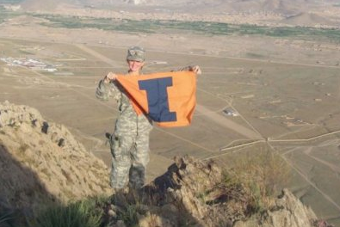
Service Members on Campus
SGT Stephenie C. Austin
Notes:
Hide this slide when printing. Make visible for the presentation.
Pic of Stephenie on a mountan outside of Kabul. Note the U of I banner, note the sidearm on her hip.

Slide 7
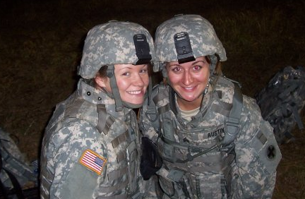
Service Members on Campus
SGT Stephenie C. Austin
Notes:
Hide this slide when printing. Make visible for the presentation.
Pic of Stephenie in “Full Battle Rattle”

Slide 8
Military-Connected Students
Reserve Component
Army & Air Force National Guard
ROTC
Veterans
Active Duty
Notes:
UC4:
Prior to flipping to this slide, ask “Who is on campus?” and “How do you know someone is in the military?”
People will generally say: ROTC.
Talking point: Yes. How do you know? In uniform.
Clarify: ROTC is an academic program. Students are in uniform once per week. They are connected with the military and will enter as officers after they graduate. They are not susceptible for deployment during school.
Talking point: Go through each as a component of students on campus.
Reserve and NG have dual responsibilities and are susceptible to deployment while in school. Note competing responsibilities such as: going to drill one weekend a month, and how does that conflict with academic responsibilities such as preparing for a midterm, reading a chapter, or writing a paper.
Veterans are no longer connected with the military and may have already deployed. Older than the traditional student. Note the challenges of self-identifying. Begin to note integration challenges, such as identifying as a vet in class and then being asked “did you kill anyone” by a fellow student. Note that they are in civilian clothes, which may be a challenge for them as it impacts their identity. Do they *want* to be in civilian clothes? What about their experience with being deployed (for some of them) but seeing ROTC get thanked for their service, when internally they are conflicted about identifying as a veteran but being resentful about having deployed and not being thanked.
How do veterans identify and find one another?
Active Duty is a minority on campus. Sometimes if a campus is close to a base, there may be an AD personnel on campus as a part time student. But this is not common (more common in places like San Diego or North Carolina or San Antonio, for instance).
Wrap up talking point: What we will talk about today is primarily Reserve/NG and Veterans. For the most part, we are not talking about ROTC (which will surprise some people) or Active Duty (except for the deployment section of the deployment cycle).

Slide 9
Service Members and Veterans on Campus - 2008
2007 – 2008
Military undergraduates represented 4% of all undergraduates
enrolled in postsecondary education
660,000 veterans
215,000 military service members
75% veterans
16% active duty
9% reserves
Military Service Members and Veterans in Higher Education: What the New GI Bill May Mean for Postsecondary Institutions, (2009). American Council on Education, Washington, DC. www.acenet.edu.
Notes:
UC4:
Although these are 2007-8 numbers, they remain the most recent numbers I’ve been able to find.
TPs are self-evident. I usually just encourage audience members to read these slides on their own.
If time permits, TPs can include:
-- military undergraduates are primarily Veterans
-- The AD # appears to be high, and probably indicates NG/Res who have been activated (this is per the published report)
Military Service Members and Veterans in Higher Education: What the New GI Bill May Mean for Postsecondary Institutions, (2009). American Council on Education, Washington, DC. www.acenet.edu.

Slide 10
Service Members and Veterans on Campus - 2008
2007 – 2008
Only about 38% of military undergraduates used their veterans’ education benefits
85% 24 or older
73% male
60% non-Hispanic white
62% had a spouse, child, or both
Military Service Members and Veterans in Higher Education: What the New GI Bill May Mean for Postsecondary Institutions, (2009). American Council on Education, Washington, DC. www.acenet.edu.
Notes:
UC4:
If time permits, note the age, gender, and marital/parental stats for veterans on campus.
-- 1 in 4 veterans on campus are women --
Military Service Members and Veterans in Higher Education: What the New GI Bill May Mean for Postsecondary Institutions, (2009). American Council on Education, Washington, DC. www.acenet.edu.

Slide 11
Service Members and Veterans on Campus - 2008
In 1980, women represented 4% of veteran population
In 2006, 1.64 million women represented
7% of all veterans, and 9% of all veterans under the age of 65
In 2006 among post-9/11 veterans,
750,000 were women, representing 16% of this population
The US Department of Veterans Affairs projects that by 2020,
the number of female veterans will reach 1.9 million,
representing 10% of the entire veteran population
Military Service Members and Veterans in Higher Education: What the New GI Bill May Mean for Postsecondary Institutions, (2009). American Council on Education, Washington, DC. www.acenet.edu.
Notes:
UC4:
Information on women as vets…note the growing #.
Military Service Members and Veterans in Higher Education: What the New GI Bill May Mean for Postsecondary Institutions, (2009). American Council on Education, Washington, DC. www.acenet.edu.

Slide 12

Deployment Stressors
© 2010 Center for Deployment Psychology
Notes:
UC4:
MAIN POINT
1st hand experience of NG that has now deployed *during* her undergraduate years. Consider: gender and role in deployment, experience outside the wire. Discuss body language when discussing driving outside the wire.

Slide 13
Campus Challenges
Administrative
Social
Visibility
Identity
Stigma/Barriers
Financial
Notes:
UC4:
This section will primarily be introductory and general, and then we will incorporate these challenges in the discussion throughout the day.

Slide 14
The Deployment Cycle
Pre-deployment
Notification
Preparation
Training
Return from Deployment
Reunion
Reintegration
Deployment
Departure
Sustainment
Combat and conflict
Notes:
14
UC4:
All phases of deployment may create stress.
Sometimes these stressors can motivate a SM.
At other times, these stressors can limit one’s ability to cope.
The Pre-Deployment stage is a time of preparation for both the SM/family.
While the SM will experience a significant increase in military related training demands, the family must prepare for the SM’s absence, both practically & emotionally.
The Pre-Deployment stage begins with the announcement of deployment and ends when the SM deploys. It is generally characterized by alternation between denial & anticipation of loss.
UC4 TP:
You will work with students in the Pre- and Post-deployment phase. We also must understand the Deployment phase so that we can help people best prepare for and return from deployment.

Slide 15
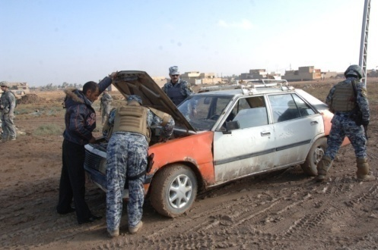

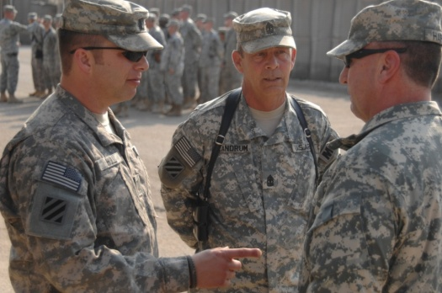
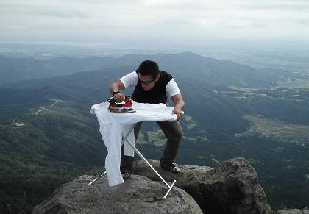
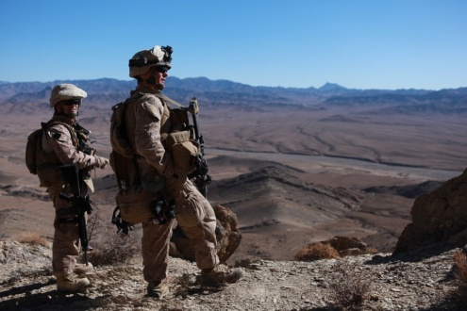

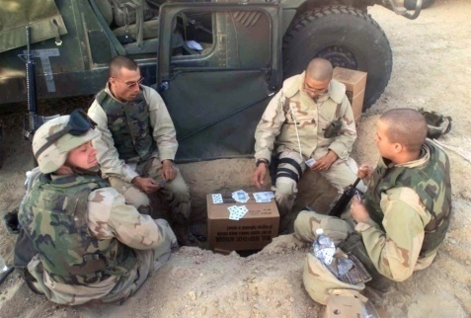
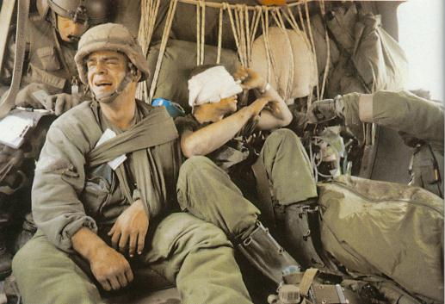
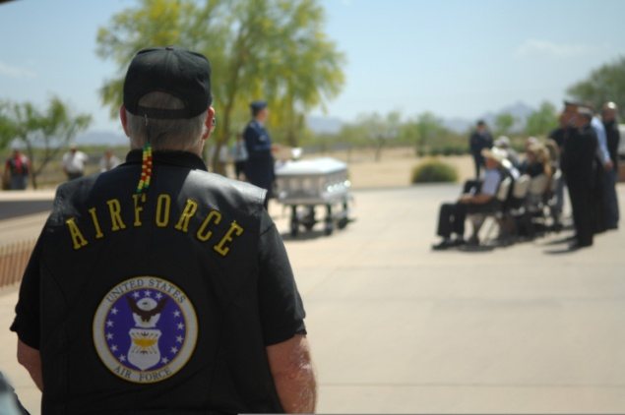
Deployment and Reintegration Challenges for Service Members
Operational
Cognitive
Social
Emotional
Spiritual
Notes:
UC4:
During the Deployment phase SMs face many stressors & demands in different aspects of their day-to-day life.

Slide 16
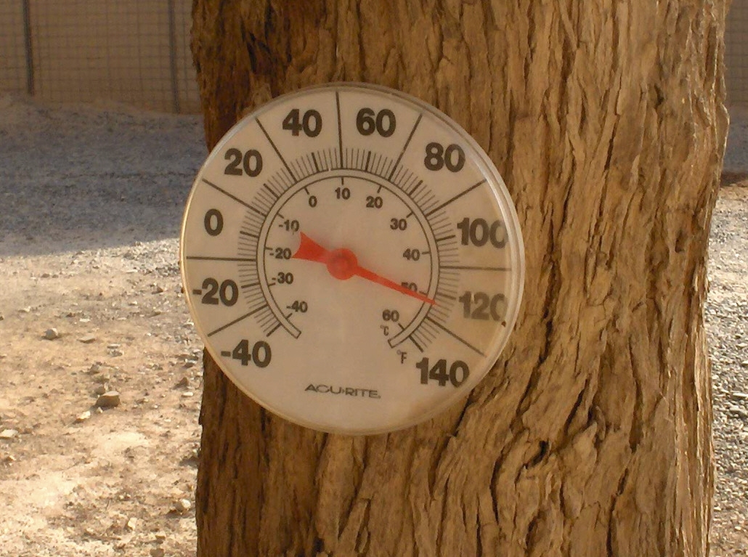
Deployment Challenges for Service Members
Operational
Heat
Dehydration
Lack of comforts
Desert
Noises
Fumes
Photo courtesy of Christopher Hines, MD
Notes:
UC4: Standard TPs
In the deployed setting, the SM does not enjoy the comforts of home. It’s often really hot or really cold, and duty often requires being out in the elements.
For those individuals deployed to FOBs or traveling from FOB to FOB (“fob-hopping”), physical/operational challenges such as weather and fumes are more often challenging.

Slide 17
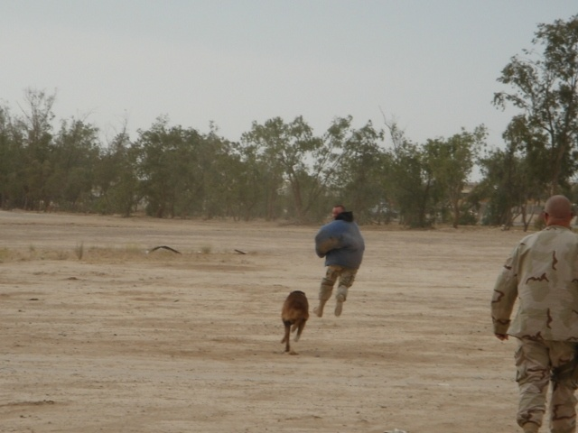
Deployment Challenges for Service Members
Cognitive
Boredom
Monotony
Unclear role or mission
Experiences that defy beliefs
Info overload
Photo courtesy of Christopher Hines, MD
Notes:
UC4: Standard TPs
Picture shows dog handlers letting the dogs chase them.
In the deployed environment, the concept of “hurry up and wait” is real and occurs often. Usually SM describe being either swamped and overworked or bored. Boredom can really take a toll on morale and makes it hard to transition when the demands of the mission change and the workload ramps up.
Many SM find it helpful to have their own personal “mission” while deployed (e.g., working on a book, reaching fitness goals, learning a new language) to keep them busy and motivated in the “down” times if there are some.

Slide 18
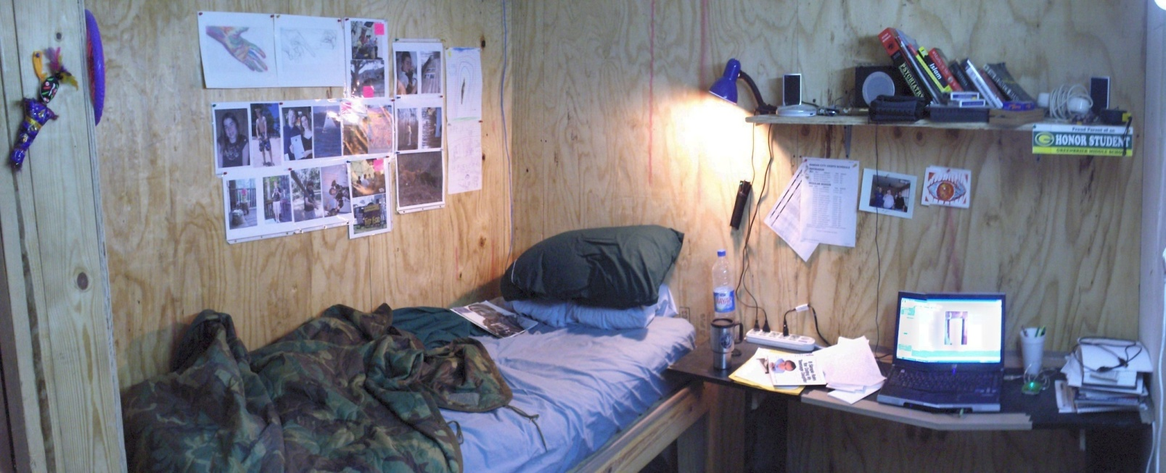
Deployment Challenges for Service Members
Social
Separation from loved ones
Lack of privacy
Public opinion and media
Facebook
Photo courtesy of Christopher Hines, MD
Notes:
UC4: Standard TPs, but note emphasis below
TP 1: This is an example of a SM sleeping quarters (probably an officer bc it is pretty nice!). Notice how the SM has made it “home.” Talk about how other sleeping quarters may differ from this—either at other bases or for lower ranking SM.
TP 2: Note the computer. I have a discussion with the audience about the pros/cons of communication via email, skype, IM, and we have the discussion about the challenges. Pros: Easier to maintain emotional connection with loved ones and get support. Cons: Difficult to be psychologically in two places at once. What if there are problems at home? It can be hard to stay “on mission.” What about the impact of family members who hear about dangerous missions, or if the SM is not available for several days? Difficult on people at home.
TP3: Discuss Facebook.
With innovations in communication technology, reaching out to loved ones in deployed settings has become easier. While increased communication is perceived as a positive development and of critical importance for families enduring a deployment, the blurring of lines between the front lines and the homefront may also have negative implications.
For SMs, intimate knowledge of family matters and problems may cause them to be distracted and have reduced focus on the mission.
Families may experience increased distress when anticipated or expected communication is cut off due to the demands of the mission or technical difficulties.
A lot of these technologies are new within the past 5 years (Facebook, IM, cell phones) → they can be good & bad. There’s increased communication, but it can be hard for SMs to see pictures of home. They may distance themselves from the family, which leads to increased family stress, and may be a distraction & cause SM to lose focus on the mission.
UC4 – Note that “Facebook breakups” in college are being experienced by SMs in deployment. There can be a grief reaction in a deployed setting based upon status changes or posted pictures.

Slide 19
Deployment Challenges for Service Members
Emotional
Fear of failure
Guilt
Horror
Fear
Anxiety
Feeling devalued
Photo courtesy of LTC Jeffrey Yarvis, PhD, MSW, MEd
Notes:
UC4: Standard TPs
Naturally, being exposed to the consequences of war can lead to emotional strain. Even for those who are not in combat units, there are events that happen that are associated with fear, sadness, guilt, etc. Sometimes these events are occurring in the deployed setting, and sometimes events happen back home that create worry and fear in the SM. Balancing the emotional rollercoaster of this is an ongoing challenge for the deployed SM.

Slide 20
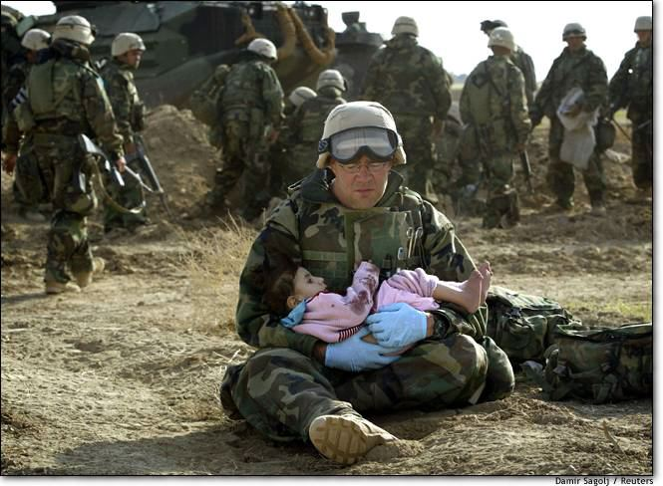
Deployment Challenges for Service Members
Spiritual
Change in faith
Inability to forgive
Loss of trust
Notes:
UC4: Standard TPs (UC4 audience will appreciate the discussion of the awareness of spirituality as a deployment challenge)
Spiritual crises during and after deployment may include: loss of faith (“how could God let this happen?”), strengthening of faith (“I would not have made it through the deployment without my spirituality”) as well as others. It can be helpful to help the SM re-evaluate his/her faith upon return from deployment if this is something that seems part of the clinical picture. At times, a referral to a pastoral counselor/chaplain can help and be an adjust to therapy.

Slide 21
Reintegration
5 critical challenges / tasks service member needs to master
1. Overcome alienation
2. Move from simplicity to complexity
3. Replace war with another form of high
4. Move beyond war and find meaning in life
5. Come to peace w/self, God, and others
CH (LTC) John Morris, Minnesota National Guard
Beyond the Yellow Ribbon reintegration program.
Notes:
21
This set of slides (5 challenges) is from Chaplin Morris – who is in the Guard – when he presented at the CDP 2-week course in 2008. Please give him credit. He’s been instrumental in the Minnesota Guard reintegration project called Beyond the Yellow Ribbon Program, which has now become the template for other states.
WE WANT YOU TO COME ALL THE WAY HOME!
To do that you will need to accomplish, along with your families, 5 METL tasks (Mission Essential Task List)
As outlined above. Each combat vet must accomplish all 5 tasks or we will be stuck between Iraq and home.

Slide 22
Campus Challenges
© 2010 Center for Deployment Psychology
Notes:
UC4:
Short video of Stephenie discussing coming back to campus. Note verbal and body language when discussing challenges. Note the disconnections from others.
Stephenie loved being a student during her sophomore and junior years: many friends, very social, successful academically. Upon returning, she was “right back to the beginning” in reference to the challenges of feeling disconnected from the campus socially.
Note that this is not a case of depression or PTSD, and we are discussing a successful, resilient student and member of the NG.
Yet her language describing her senior year: “off” and “wrong”
Body language: squirming, scratching thigh, etc.

Slide 23
BATTLEMIND Skills
WHILE DEPLOYED HOME
Post -Deployment
Buddies (cohesion) vs. Withdrawal
Accountability vs. Controlling
Targeted Aggression vs. Inappropriate Aggression
Tactical Awareness vs. Hypervigilance
Lethally Armed vs. “Locked and Loaded” at Home
Emotional Control vs. Anger/Detachment
Mission OPSEC vs. Secretiveness
Individual Responsibility vs. Guilt
Non-Defensive Driving vs. Aggressive Driving
Discipline and Ordering vs. Conflict
Notes:
UC4: We do a disservice when we look at “symptoms” (on the right), combine that info with a deployment history, and determine that it’s a case of PTSD. It *could* be a case of PTSD, but if the challenge is reintegration (not turning off skills that kept a person alive), then PTSD treatment will be ineffective. Similarly, if someone has PTSD and they are being treated with a goal of simply “turning off” the survival skills, the PTSD will persist.
Overall talking point: Most people *do not* have PTSD. A significant minority do. It is imperative that we understand the complexities of PTSD as well as reintegration, and be able to offer the proper treatment.
Standard TPs:
Army had a program designed to train people to prepare for deployments and to come home. When in theater, you rely on BATTLEMIND skills to keep you alive but they can cause problems if they continue at home
Go through them all:
B: Rely on Buddies to keep you alive, bond, trust BUT when you’re at home it becomes hard to trust anyone else
A: Maintaining your weapon/gear is necessary for survival BUT can lead to anger at home when someone messes with your stuff
T: Anger keeps you pumped (kill or be killed) BUT can lead to hostility toward others, assault, abuse
T: Survival depends on constant awareness BUT can lead to anxiety in crowds and being easily startled by loud noises
L: Carrying a weapon is a life and death necessity BUT can lead to feeling unsafe without a weapon when home
E: Controlling emotions is critical for mission success BUT can lead to not showing emotions (except anger) and detachment
M: It’s important to talk about the mission only with those with a need to know BUT can lead SMs to not share any of their deployment experiences with their loved ones
I: Your responsibility in combat is to survive & help your buddies BUT can lead to feelings of guilt about those wounded or KIA
N: Driving in country is designed to avoid IEDs BUT can lead to unsafe driving back home
D: Survival depends on discipline & obeying orders BUT can result in SMs to be demanding when at home and can lead to conflicts
The right hand side (HOME) can look like PTSD, but it could only be re-integration (highlights the importance of proper assessment). While it’s important to know a SM’s trauma history, this information is important because the symptoms can look so similar. Reintegration can be THE work of therapy – work to help them come home.

Slide 24
Deployment
Social Alienation
Financial
Culture
Academic & Career
Reintegration
Spiritual
Notes:
UC4:
…and as a review from this morning’s section, we’ve seen extensively today that if somebody has been deployed, there may be significant effects on any number of areas in the person’s life. And we’ve looked at how these challenges can manifest themselves on campus.

Slide 25
Deployment
Depression
PTSD
Substance Use/Abuse
Insomnia
Suicide
mTBI
Relationship Problems
Notes:
UC4:
In addition to the social, cultural, and experiential concerns of the SM/Vet, we *do* have to be aware of the more common clinical concerns associated with deployment. It should be noted that *not all* of the above are associated with *military service.* For instance, there is no evidence the military service in and of itself precipitates higher rates of depression or PTSD. However, a deployment experience *does* precipitate higher rates of these disorders. Deployment is a factor in the development of each clinical condition listed above, and we as clinicians must be prepared to understand the intersection of deployment and clinical care.
We will not have the time today to go through each of these, as that would be a training that would demand far longer than a full day (much less a one-hour segment in the afternoon). Resources are provided at the end of the powerpoint.
With this chart, we are trying to both expand and focus the ways we conceptualize clients. The circles can easily be moved around, moved in and out, removed, or added. It is possible that all of these can go together, and it is possible that a SM could experience only one at a time. It is also possible (even probable) that someone will experience deployment and not succumb to any diagnosable clinical condition.

Slide 26
RESILIENCE
Notes:
We often talk about resilience, and we’ve discussed throughout the day the need to recognize that *most* people do not return from deployment with a diagnosable clinical condition. However, that does not mean they have not been under stress.
Make the statistical point that most people do not have PTSD, Depression, or TBI. But that we must be aware that a significant minority do.

Slide 27
Unit cohesion
High leadership
Proper training
Social support
Proper dwell time
Other
High
Single deployment
Short deployment
Low/No combat
Supportive relationship
No trauma
Other
Multiple deployments
Long deployments
High combat ops
Relationship stress
Trauma Fatigue
Moral injury
Grief
Other
Resilience
Low
Combat Stress
Combat Stress
High
Resilience
Low cohesion
Low leadership
Poor training
Isolation
Short dwell time
Other
Low
Notes:
UC4:
ANIMATED SLIDE
Open up the talking point that some people have tools, skills, and protective factors that help reduce their vulnerability to clinical conditions. However, some do not. Consider the matrix above. Many SMs will have experienced high combat stress, but they may also display a great deal of protective factors that reduced their vulnerability to clinical concerns. Of course, some who have experienced high combat stress but do not have the resources to manage that stress may fall into significant, critical conditions.
On the other hand, low combat stress may also lead to critical clinical conditions if the resources are low.
ANIMATION brings in the examples of low/high combat stress and low/high resilience. Discuss as necessary.

Slide 28
Combat and military resilience
Academic and campus resilience
Notes:
UC4
It is therefore important to understand the different resources and skills needed for the resilience that can contribute to combat or academic success.
The things that make a soldier resilient from combat *may not* be the things that ensure academic or student success. They may not be in line with one another. It is entirely possible to have a successful SM struggle at school, and it is also entirely possible that someone who struggled in the military may be a very successful student. This is why we must expand our conceptualizations. The military experience, like the academic experience, is not black/white, nor is it all defining. These matrices are one way to expand our conceptualizations.

Slide 29
Task completion
Academic fit
Commitment
Discipline
Support
Skills
Other
High
Poor attention
Undisciplined
Bad fit
Introvert/independent
Individualist
Other
Task completion
Commitment
Discipline
Teamwork
Support
Sacrifice
Skills
Other
Academic Skills
Low
Military Skills
Military Skills
High
Academic Skills
Poor attention
Lacks structure
Poor goal setting
Lack of skills
Little support
Other
Low
Notes:
UC4
ANIMATED SLIDE
Some examples of how this matrix might look

Slide 30
Outreach Efforts

Slide 31
SM/Veteran
Other Veterans
Friends and Family
Faculty and Classroom
Veteran Service Office
Financial Aid
Clergy
Counseling Center
Mental Healthcare Providers
University
Administration
Student Affairs
Etc.
Notes:
UC4:
ANIMATED SLIDE
The SM/Vet can have a perimeter around him/her, and only a few people might have access (see above for common examples). At the same time, there are at least two major campus organizations/departments with direct interest in reaching the veteran, but they may not be able to do so. Those two organizations (Counseling Center and Student Affairs), often work very closely together. These orgs can in turn reach out to the people/departments who are on the Vet’s perimeter but who have access. With the right effort, the goal is to work with the community and people on the perimeter to gain access to the Vet.
IF you are able to get through the perimeter to the Veteran:
Be prepared to address the alliance from the first moment. “Hallway Therapy” is common in VAs, and “Quad Therapy” is useful on campus. In a deployment, it is not uncommon for SMs/Vets to have clinical contact with a MH professional or chaplain in the open. Clinicians must be prepared if the opportunity presents itself.
On the other hand, the barriers to care and concerns of confidentiality can be the concern that prevents the Vet from trusting outside the perimeter. Be prepared to discuss confidentiality with the client at the first session. SMs/Vets know that their mental health records can be requested/required to be provided if they seek future employment with the military or FBI/CIA/Law enforcement. Your clinics are regularly visited by federal marshals requesting records and/or an interview with the clinician. Usually these are not difficult situations, but what happens in the first session and how the issue of “what will be put in the record” is a crucial matter. That might be the one and only chance to forge an alliance with the SM/Vet, and it can happen the instant you sit down. Have the discussion in your clinical case conferences about how to prepare to discuss confidentiality with SMs/Vets.
Be prepared to discuss “hot-button” diagnoses/impressions such as: substance abuse, bipolar d/o, personality d/o.
Vocational/career counselors: Many SMs/Vets pursue work in law enforcement or another govt agency (FBI, CIA, etc.). However, it is important not to make this assumption. If you are working with someone, ask what their MOS (job) was in the military, as well as finding out the reason they joined the military in the first place. Both of those topics can greatly inform the possibilities to be discussed for future directions (Did the military work for you? Did you like your job? Did it meet your expectations? Was it fulfilling? Yes or no on any of those will inform the next steps…)

Slide 32
Outreach 101 – Needs Assessment
Campus Profile
Best estimate, approximate, or exact numbers below:
Undergraduate students:
Graduate students:
Veteran students:
National Guard/Reserve:
Active Duty:
GI Bill recipients:
State Grant recipients:
Minimum # identified:
Approximate/identified total:
4% of total undergraduate:
(Military veterans comprise approximately
4% of national undergraduate population.)
Outreach 101
Needs Assessment
Who is on campus
Best estimates
Strengths v. Weaknesses
What programs are in place
Web portals
Dedicated student groups
Dedicated offices/liaison
Ability to communicate
Notes:
UC4:
Outreach 101
(Note: the breakdown of Outreach 101, 201, 301, and 401 sets up the afternoon Large Group Outreach Exercise)
The first step in any outreach is the need to determine exactly who your target audience/community is. How many SMs/Vets are on your campus, and what are the strengths and weaknesses of your campus? Each campus will be different.
Write a needs assessment. Does not need to be a year-long, IRB-approved document. Can be a 10 page report written by an interested intern or anybody with an interest.
Include basic strengths and weaknesses. This is not a judgmental document. Identify, to the best that you can, the number of SMs and vets on campus. If this number cannot be identified, then that is the weakness that is articulated in the document (eventually this turns into a goal for the university).
Investigate career services, disability services, financial aid, housing, student affairs, etc. Determine if there are any programs in place. If not, note that fact.
This document provides an outline of campus needs and informs the first steps towards outreach efforts.
NOTE: Show people the Needs Assessment – Outreach Worksheet that is at the back of the packet. The “Campus Profile” box is represented on the slide deck above. There are three other boxes on the worksheet. This worksheet can be filled out very quickly and assist/augment a campus planning/outreach discussion.
Go through the Campus Profile box quickly to identify some pointers (e.g. you can have question marks next to many of the groups, but if you have only a couple then that’s a start).

Slide 33

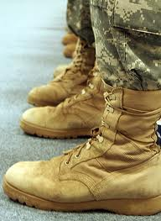


Outreach 201 – Direct Service
“Boots to Books”
Outreach 201
Direct Services to SM/Vets
Psychoeducation
Build/strengthen the community
Clinical & Non-clinical services
How to reach SM/Vets
Support Groups
Open Hours
Notes:
UC4:
Outreach 201 – This consists of implementing some “bottom up” programming. These are usually implemented by Counseling Centers, but don’t have to be.
Basic psychoeducation classes, groups, events…each of these are worthy attempts to directly reach the SM/Vet and also strengthen the community.
Some examples/anecdotes below:
At U of I we started with a 90 minute psychoeducation program called “Boots to Books,” which included material about depression, PTSD, and reintegration challenges. We put up flyers and invited SMs and Vets for a Tuesday night at 7pm. First meeting 8-9 people. Second meeting 4-5. Third meeting 2-3.
The fourth meeting, no one came for 60 minutes. We were about to wrap up when a guy snuck around the corner of the doorway and sheepishly asked “Is this the vet thing?” We invited him in and got to know him. What did we learn? 1) He didn’t believe it was actually happening (otherwise he would have been on time). 2) He really needed/wanted to be there (otherwise he wouldn’t have come at all). Conclusion: This was a successful outreach despite the low attendance and apparent no-show for the first hour.
Of course, we want more people to participate in our efforts…so…
We evaluated the programming that we had offered, and determined that maybe our approach was fine for psychoeducation, but was not appropriate for addressing the larger concerns of the community. We came to the conclusion that maybe putting on a program teaching about PTSD, depression, and reintegration challenges was exactly *opposite* of the message we wanted to send. We then offered a non-clinical support group in an effort to build a community. If you look at a VA, you will notice that Vets hang out at the canteen. They don’t even need an appointment to visit with their friends over a cup of coffee. So we offered coffee and donuts (inexpensive, and a realistic alternative to pizza and beer on a college campus).
We sent the message (through flyers and other channels) that this was *their* meeting and *their* agenda (the Veterans’), and that we were merely offering a space to congregate, have a cup of coffee, and meet one another. We put some structure/boundaries around the meeting (no recruiting, no political agenda).
Our attendance increased again, and then dipped again. Why did it dip again? Because the vets who had met each other were then meeting for pizza and beer. Did this mean that our outreach program was a failure because of the dip in attendance? No, of course not. The community was strengthened because those vets having pizza and beer were no longer isolated.
Consistent, visible programming is invaluable, and attendance cannot be the only metric used to determine success of a program.
RSO and Facebook talking points:
UC4:
Is there a Registered Student Organization (RSO) at the school? If so, put a screenshot here. If not, put a screenshot of where it *isn’t* here. If you can’t find it but they have one, note that, and discuss the challenges of finding the information for the RSO online.
Follow-up: How many Vets are members of the RSO? Usually it’s a small percentage of the total estimated on Campus. Sometimes a few dozen, at best (San Diego State) several hundred. But these numbers indicate that even the strongest RSO will not be able to reach all SMs/Vets on campus.
Example: No RSO at IU on the online portal. When I did the presentation, they said that they *did* have an RSO, and then I simply used my efforts (and failure) to find the RSO as an example of how difficult it is to reach Vets.
Related to discussion of RSO:
Is there a Facebook page? I take screenshots of a Vet page for a specific campus. Then I will note how many people are members of the group. Same point as the RSO. Sometimes the RSO and FB page are the same. Sometimes completely different.
In any case, you are bringing awareness to how many people are *missing* from these groups.
Example: only 26 members at IU
COUNSELING CENTER’S ROLE: Can you identify student leaders to participate in outreach programming? To start an RSO? To organize the Facebook page? Anecdote: At U of I, we identified an invested student leader two years in a row. Each year just as the RSO was about to be formed, that individual deployed. Take home: This can be a transient population, making outreach more difficult and posing unique challenges in generating continuity for programming.

Slide 34
Outreach 301 Institutional Education
Outreach 301
Educate Staff/Faculty
Professors
Advisors
Administrators
Res Halls
Financial Aid
Registrars
Grad Assistants
What do they need to know?
Deployment Cycle stress
Military Culture
Social Challenges
Return to Campus
Other
15 – 30 Min Program
Notes:
UC4:
Outreach 301
There are thousands of university personnel coming in contact with SMs/Vets (classroom, dining facility, res halls, advisors, fin aid, student affairs, etc.)
Can the Counseling Center or Student Affairs put together a 30 minute program incorporating the salient point’s of today’s discusion and present to groups of university personnel? 15-minute? Include basic info like: Who is on campus (more than ROTC), basic campus stressors, awareness of Deployment cycle stress, break stereotypes, where is the Vet center, etc. If you can’t get 30 minutes, can you get 15? What needs to be said? This is mostly determined on a local level, but take the basic themes from this presentation and re-work them to fit your audience and what needs to be presented. Make this an ongoing series offered to the university community every year.

Slide 35
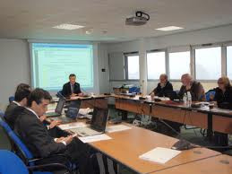
Outreach 401 – Advocacy/Support
Outreach 401
Advocacy
Institutional Support
Steering Committee
ODOS/Student Affairs
Financial Aid
Counseling Center
Disability Services
Housing
Chancellor/Provost Offices
Etc.
Long-term Campus Plan
Financial Resources
- Steering Committee
Notes:
UC4:
(Optional: You can make a joke about people in a room looking at powerpoint slides.)
Can you create a steering committee with one or two reps from each of the offices above?
Start with your needs assessment, and then this administrative group can take a hard look at what steps need to be taken. Outreach efforts…with both successes and failures should be discussed. Examine web portals, as well as the presence or absence of specific personnel and/or services (Counseling Center, Disability Servies, Financial Aid, etc.). Examine the role of a potential Veterans Liaison (becoming common…and sometimes legally mandated). Discuss resources…many campuses claim “Veteran friendly” but do not have any resources dedicated to SMs/Vets. Explore the meaning and dedication of visible programming. Address whether or not the university tracks SM/Vet status at the administrative level (beyond the Financial Aid level). Explore ways to increase access to SMs/Vets via some form of communication (e.g. if you want to email them, do you have a usable list? How can you get one?).

Slide 36

Following Deployment

Slide 37
Training resources….

Slide 38
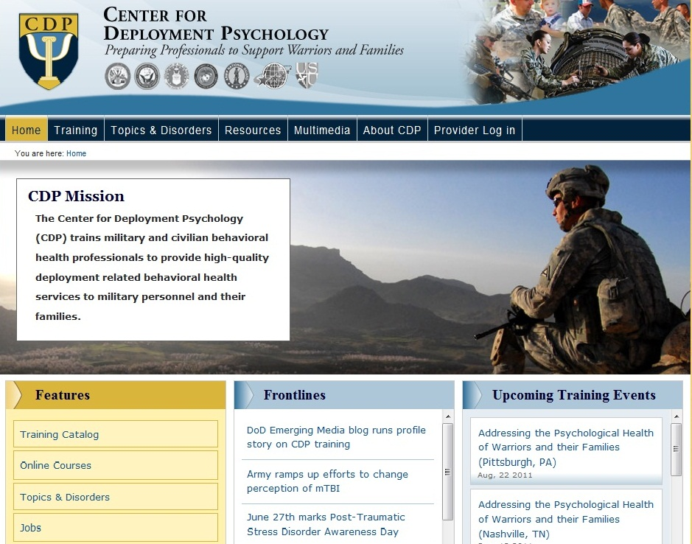
CDP Website: www.deploymentpsych.org
Features include:
Schedules and descriptions of training events
Articles by subject matter experts related to deployment psychology, including PTSD, mTBI,depression, and insomnia
Descriptions of books and resources on military-related topics
Latest news related to deployment psychology
Links to CDP’s Facebook and Twitter pages

Slide 39
Online Learning
The following online courses are located on the CDP’s website at:
deploymentpsych.org/training/online-courses
NOTE: These courses can be taken for free or for CE Credits for a fee
Cognitive Processing Therapy (CPT) for PTSD in Veterans and Military Personnel (2.5 CE Credits)
Prolonged Exposure (PE) Therapy for PTSD in Veterans and Military Personnel (2 CE Credits)
Epidemiology of PTSD in Veterans and Military Personnel : Working with Service Members and Veterans with PTSD (2.5 CE Credits)
Military Cultural Competence (3 CE Credits)
The Impact of Deployment and Combat Stress on Families and Children, Part 1 (5 CE Credits)
The Impact of Deployment and Combat Stress on Families and Children, Part 2 (3.5 CE Credits)
The Fundamentals of Traumatic Brain Injury (TBI) (4 CE Credits)

Slide 40
UC4
University Counseling Center
Core Competency Program
http://deploymentpsych.org/training/uc4
Ted C. Bonar, PsyD
Chief, Continuing Education Programming
tbonar@deploymentpsych.org
Mary Schuble
Project Manager, Continuing Education Programming
mschuble@deploymentpsych.org
Notes:
Prep work:
# of undergrads:
# of vets (estimate 3 – 4%):

Slide 41
Questions and Discussion
Thank You

Slide 42
Clinical Resources

Slide 43
Prolonged Exposure Therapy for PTSD:
Emotional Processing of Traumatic Experiences
Therapist Guide
Foa, E.B., Hembree, E.A., & Rothbaum, B.O. (2007)
Oxford University Press
www.oup.com
Notes:
43
UC4 – no discussion
ORIENT participants to the materials on hand. This will maximize the audience’s ability to follow along during the subsequent session-by-session synopsis of the therapy,
MAKE sure participants have their manual in front of them, including the various handouts and veteran examples, and that the materials are organized by session. This step is particularly important if the materials have been sent electronically because sometimes individuals will organize their printed copies differently. It is sometimes difficult for therapists to leave a training with a good overall idea of what takes place in each session because the reference for that is essentially the entire treatment manual.
REFER to the summaries of each session that precedes the session content. These handouts can also be helpful to illustrate the expected timing/pacing of each session as time estimates for each section are indicated.

Slide 44
Cognitive Processing Therapy for Rape Victims:
A Treatment Manual
Resick, P.A. & Schnicke, M.K. (1993)
Sage Publications
Notes:
44
UC4 – no discussion on this
ORIENT participants to the materials on hand. This will maximize the audience’s ability to follow along during the subsequent session-by-session synopsis of the therapy,
MAKE sure participants have their manual in front of them, including the various handouts and veteran examples, and that the materials are organized by session. This step is particularly important if the materials have been sent electronically because sometimes individuals will organize their printed copies differently. It is sometimes difficult for therapists to leave a training with a good overall idea of what takes place in each session because the reference for that is essentially the entire treatment manual.
REFER to the summaries of each session that precedes the session content. These handouts can also be helpful to illustrate the expected timing/pacing of each session as time estimates for each section are indicated.

Slide 45
Cognitive Processing Therapy
Veteran/Military Version
Resick, P.A., Monson, C.M., & Chard, K.M. (2008)
Produced by VA Office of Mental Health, VA National Center for PTSD/ VA Boston Healthcare System and Cincinnati VA Medical Center
Notes:
45
UC4 – no discussion on this
ORIENT participants to the materials on hand. This will maximize the audience’s ability to follow along during the subsequent session-by-session synopsis of the therapy,
MAKE sure participants have their manual in front of them, including the various handouts and veteran examples, and that the materials are organized by session. This step is particularly important if the materials have been sent electronically because sometimes individuals will organize their printed copies differently. It is sometimes difficult for therapists to leave a training with a good overall idea of what takes place in each session because the reference for that is essentially the entire treatment manual.
REFER to the summaries of each session that precedes the session content. These handouts can also be helpful to illustrate the expected timing/pacing of each session as time estimates for each section are indicated.

Slide 46
CBT-Insomnia – Resources
Cognitive Behavioral Treatment of Insomnia: A Session-by-Session Guide
Perlis, Jungquist, Smith, & Posner (2008).
Insomnia: A Clinical Guide to Assessment and Treatment
Morin & Espie (2004).
Notes:
Offer resources

Slide 47

TBI – Resources
Defense and Veterans Brain Injury Center
www.dvbic.org
Notes:
Resources…

Slide 48
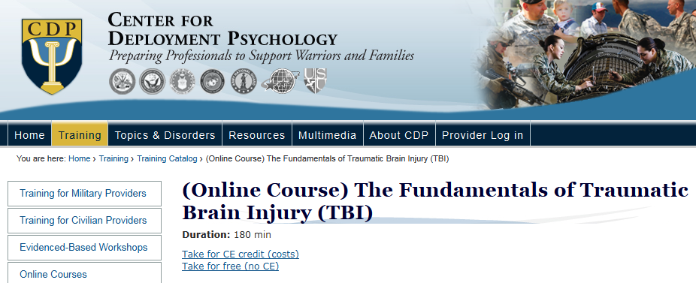
TBI – Resources
Center for Deployment Psychology Online Training
The Fundamentals of Traumatic Brain Injury
http://deploymentpsych.org/training/online-courses

Slide 49

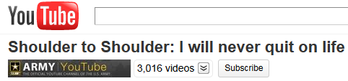
Suicide Prevention Video
http://www.army.mil/media/amp/
Notes:
Resources…

Slide 50

http://www.healthquality.va.gov/management_of_concussion_mtbi.asp

Slide 51
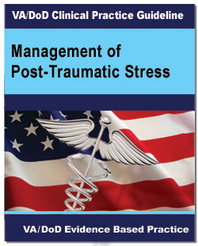
http://www.healthquality.va.gov/Post_Traumatic_Stress_Disorder_PTSD.asp

Slide 52

http://www.healthquality.va.gov/Major_Depressive_Disorder_MDD_Clinical_Practice_Guideline.asp

Slide 53

http://www.healthquality.va.gov/Substance_Use_Disorder_SUD.asp

Slide 54
Campus Planning
Notes:
UC4:
The following slides contain documents available for free download that are useful resources for serving Vets on campus

Slide 55
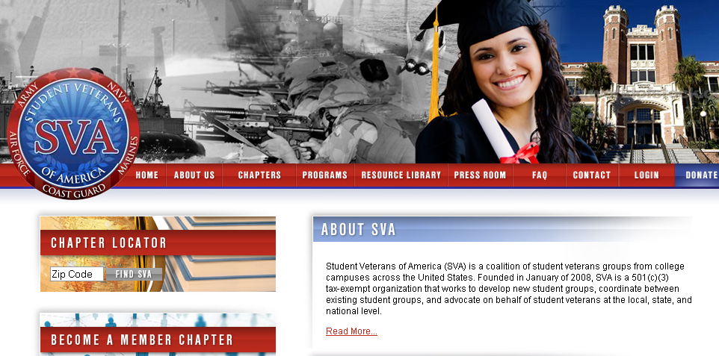
www.studentveterans.org

Slide 56
Student Veterans of America: Veteran Center Plan
Step 1: Develop a Veterans Task Force
Step 2: Support a Student Veterans Organization
Step 3: Create Veteran’s Office
Step 4: Set up Space
Step 5: Develop Online & Print Resources
Step 6: Establish Partnerships
Step 7: Educate Administration, Faculty & Staff
Step 8: Converge all Resources in One Place
Step 9: Evaluate Organizational Success
Download with details available at: www.studentveterans.org

Slide 57

American Council on Education
www.acenet.edu

Slide 58
American Council on Education: Campus Recommendations
Serving Those Who Serve: Making Your Institution Veteran-Friendly
Publish Concise Information on Transfer Credit for Military Experience
Take a Community-Based Approach
Give Your Veterans a Voice
Build a Strong Web Presence
Establish Specific Points of Contact
Expand Housing Options
Implement a tuition Deferment Plan
Download with details available at: www.acenet.edu

Slide 59

American Council on Education
www.acenet.edu

Slide 60

American Council on Education
www.acenet.edu

